Slide 1
Numpy Tutorial

Slide 2
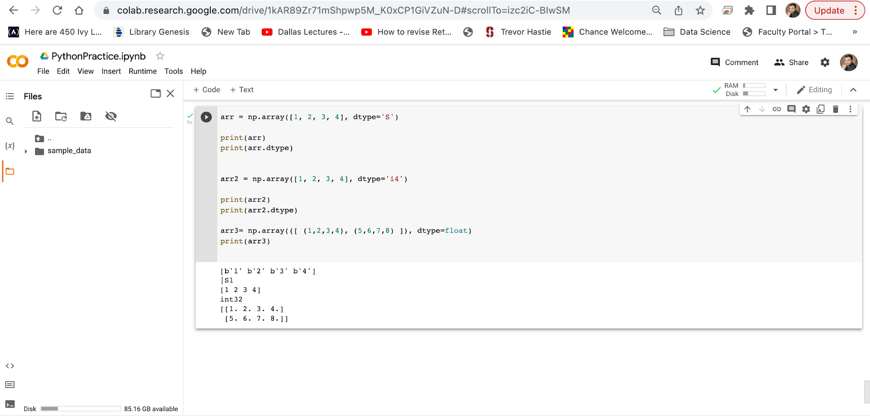
Google Colab
Create an array with data type string.
For i, u, f, S and U we can define size as well.
Create an array with data type 4 bytes integer:
Created a floating point 2-D array

Slide 3
Google Colab
NumPy Introduction
What is NumPy?
NumPy stands for Numerical Python.
NumPy is a Python library used for working with arrays.
It also has functions for working in domain of linear algebra, fourier transform, and matrices.
NumPy was created in 2005 by Travis Oliphant. It is an open source project and you can use it freely.

Slide 4
Google Colab
NumPy Introduction
Why is NumPy Faster Than Lists?
NumPy arrays are stored at one continuous place in memory unlike lists, so processes can access and manipulate them very efficiently.
This behavior is called locality of reference in computer science.
This is the main reason why NumPy is faster than lists. Also it is optimized to work with latest CPU architectures.

Slide 5
Google Colab
NumPy Introduction
Why Use NumPy?
In Python we have lists that serve the purpose of arrays, but they are slow to process.
NumPy aims to provide an array object that is up to 50x faster than traditional Python lists.
The array object in NumPy is called ndarray, it provides a lot of supporting functions that make working with ndarray very easy.
Arrays are very frequently used in Machine Learning and data science, where speed and resources are very important.

Slide 6
Google Colab
NumPy Introduction
Which Language is NumPy written in?
NumPy is a Python library and is written partially in Python, but most of the parts that require fast computation are written in C or C++.
Where is the NumPy Codebase?
The source code for NumPy is located at this github repository https://github.com/numpy/numpy
github: enables many people to work on the same codebase.

Slide 7
Google Colab
Installation of NumPy
If you have Python and PIP already installed on a system, then installation of NumPy is very easy.
Install it using this command:
!pip install numpy
If this command fails, then use a python distribution that already has NumPy installed like, Anaconda, Spyder etc.

Slide 8
Google Colab
Import NumPy
NumPy as np
NumPy is usually imported under the np alias.
alias: In Python alias are an alternate name for referring to the same thing.
Create an alias with the as keyword while importing:
import numpy as np
Now the NumPy package can be referred to as np instead of numpy.

Slide 9
Google Colab
Import NumPy
Create a NumPy ndarray Object
NumPy is used to work with arrays.
The array object in NumPy is called ndarray.
We can create a NumPy ndarray object by using the array() function.

Slide 10
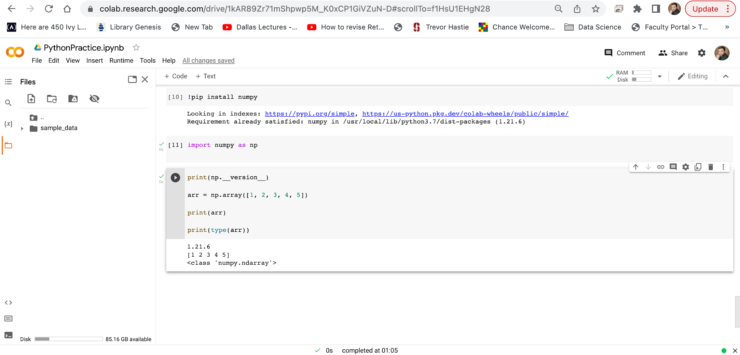
Slide Title
Checking NumPy Version
The version string is stored under __version__ attribute.
Create and Print numpy Array using array()
type(): This built-in Python function tells us the type of the object passed to it. Like in above code it shows that arr is numpy.ndarray type

Slide 11
Google Colab
Import NumPy
Create a NumPy ndarray Object
To create an ndarray, we can pass a list, tuple or any array-like object into the array() method, and it will be converted into an ndarray.
Let’s Use a tuple to create a NumPy array.

Slide 12
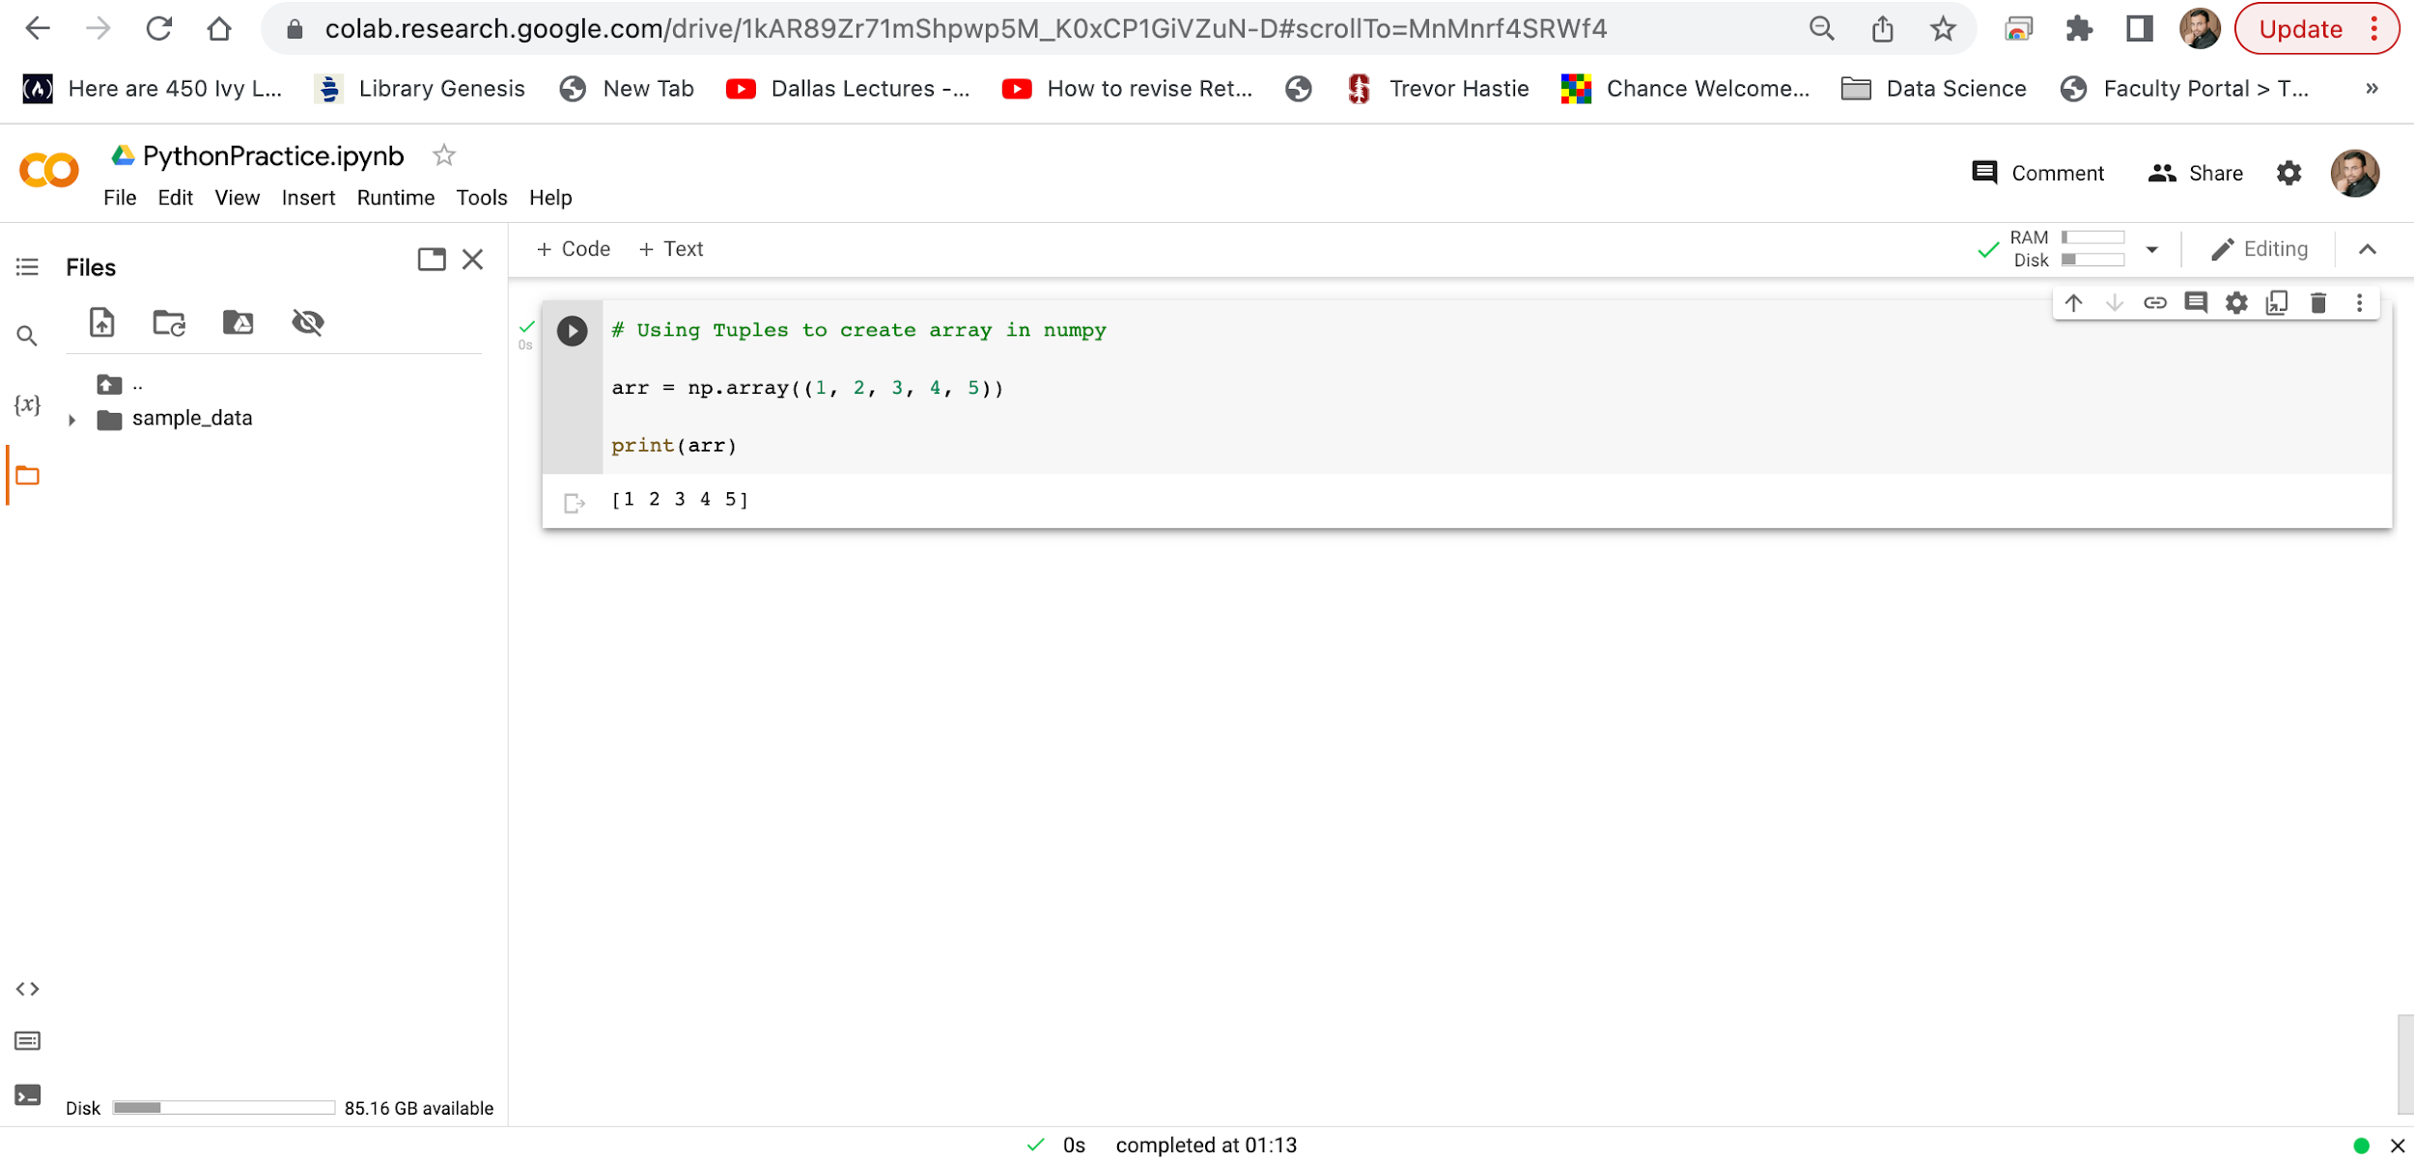
Slide Title

Slide 13
Google Colab
Dimensions in Arrays
A dimension in arrays is one level of array depth (nested arrays).
Nested array: are arrays that have arrays as their elements.
0-D Arrays
0-D arrays, or Scalars, are the elements in an array. Each value in an array is a 0-D array.
1-D Arrays
An array that has 0-D arrays as its elements is called uni-dimensional or 1-D array.
These are the most common and basic arrays.
2-D Arrays
An array that has 1-D arrays as its elements is called a 2-D array.
These are often used to represent matrix or 2nd order tensors.
3-D arrays
An array that has 2-D arrays (matrices) as its elements is called 3-D array.
These are often used to represent a 3rd order tensor.
NumPy has a whole sub module dedicated towards matrix operations called numpy.mat

Slide 14
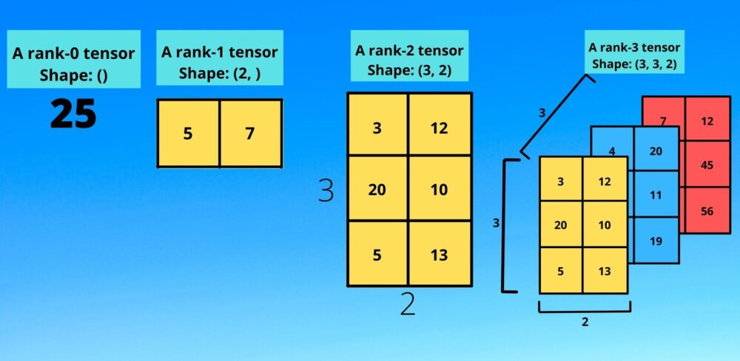
Google Colab

Slide 15
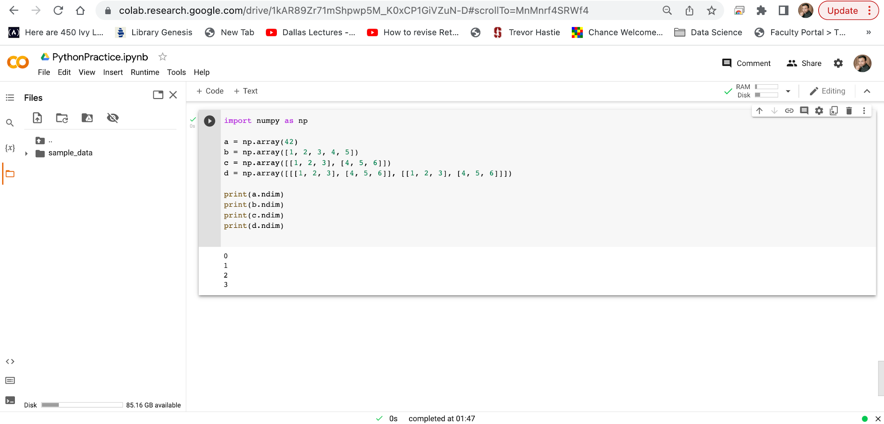
Google Colab
NumPy Arrays provides the ndim attribute that returns an integer that tells us how many dimensions the array have.

Slide 16
Google Colab
Dimensions in Arrays
Higher Dimensional Arrays
An array can have any number of dimensions.
When the array is created, you can define the number of dimensions by using the ndmin argument.

Slide 17
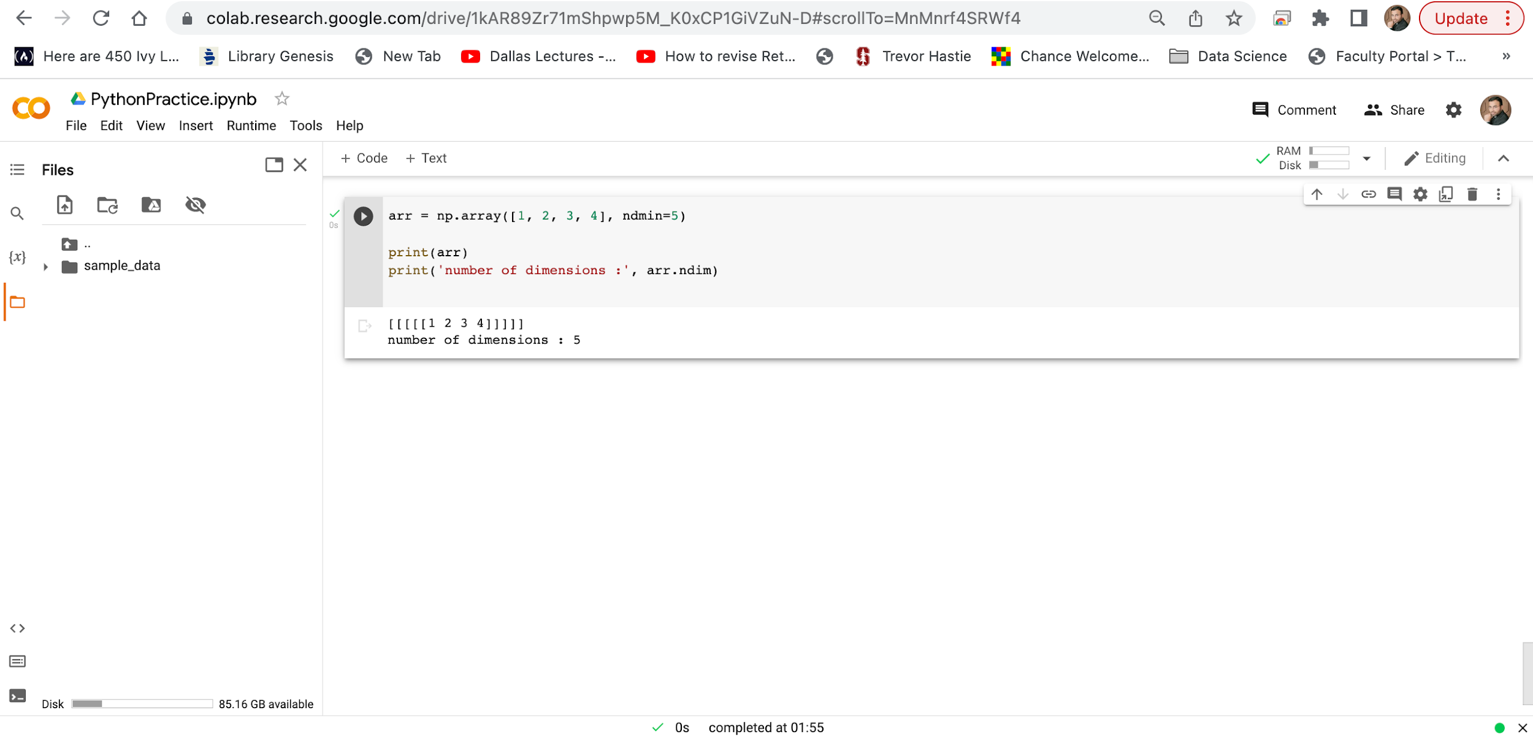
Google Colab
Create an array with 5 dimensions and verify that it has 5 dimensions.
In this array the innermost dimension (5th dim) has 4 elements, the 4th dim has 1 element that is the vector, the 3rd dim has 1 element that is the matrix with the vector, the 2nd dim has 1 element that is 3D array and 1st dim has 1 element that is a 4D array.

Slide 18
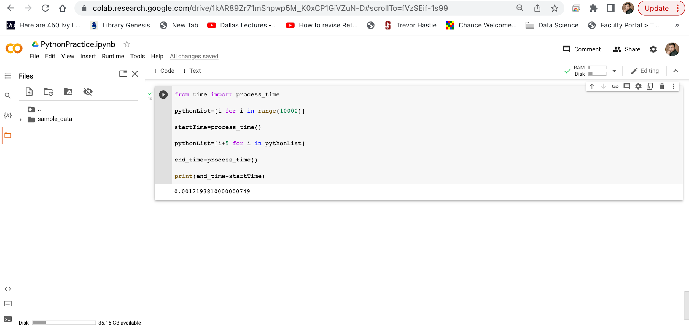
Google Colab
Time is another Library that we need to import. It gives us time, it is used to calculate time taken by a particular process.
We have created a python list of 10,000 elements using for loop shorthand syntax.
We noted the start time and saved it in a variable start_Time.
We added 5 in all elements of python list that we created earlier.
We noted the end time and saved it in a variable end_Time.
We calculated the difference between end_Time and start_time to check the time taken by this process.

Slide 19
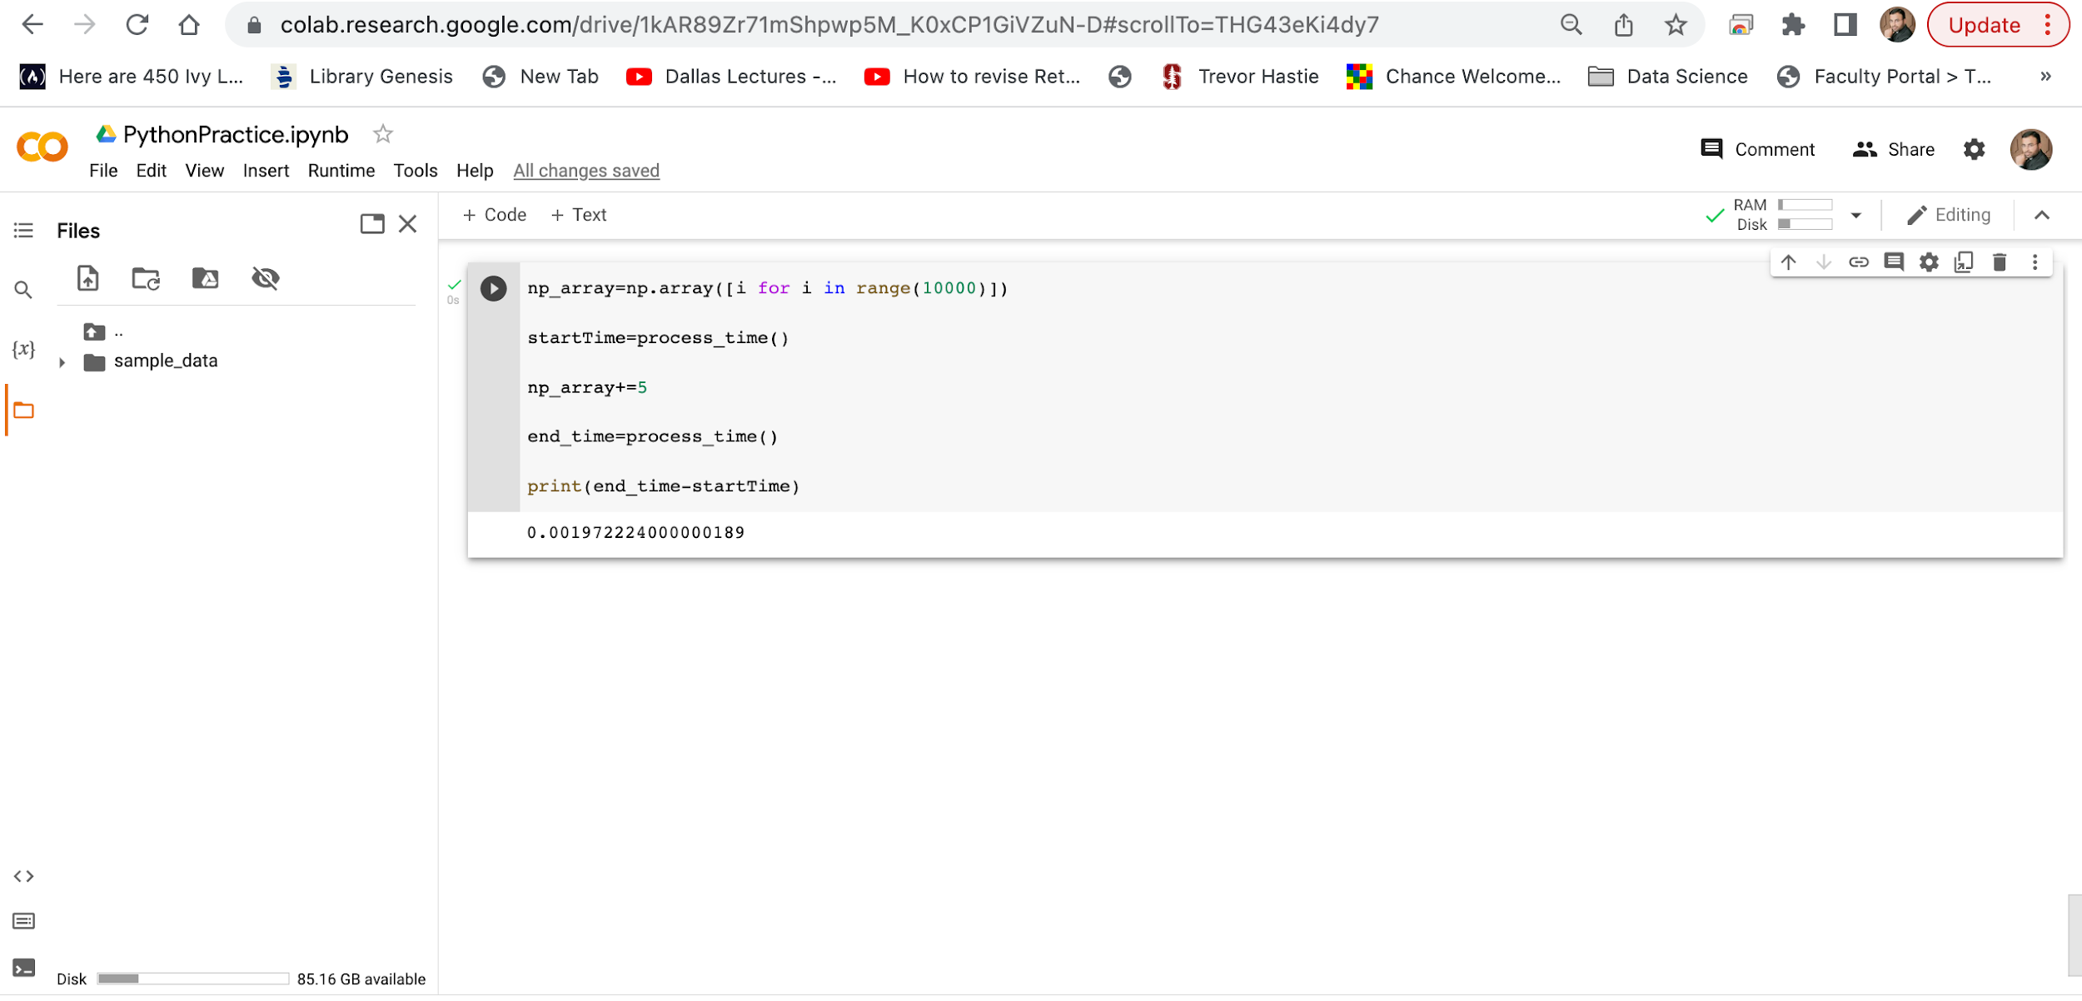
Google Colab
We have created a nupy array of 10,000 elements using for loop shorthand syntax.
We noted the start time and saved it in a variable start_Time.
We added 5 in all elements of python list that we created earlier.
We noted the end time and saved it in a variable end_Time.
We calculated the difference between end_Time and start_time to check the time taken by this process.
We can see that numpy arrays are number of times faster then the python lists

Slide 20
Google Colab
NumPy Array Indexing
Access Array Elements
Array indexing is the same as accessing an array element.
You can access an array element by referring to its index number.
The indexes in NumPy arrays start with 0, meaning that the first element has index 0, and the second has index 1 etc.

Slide 21
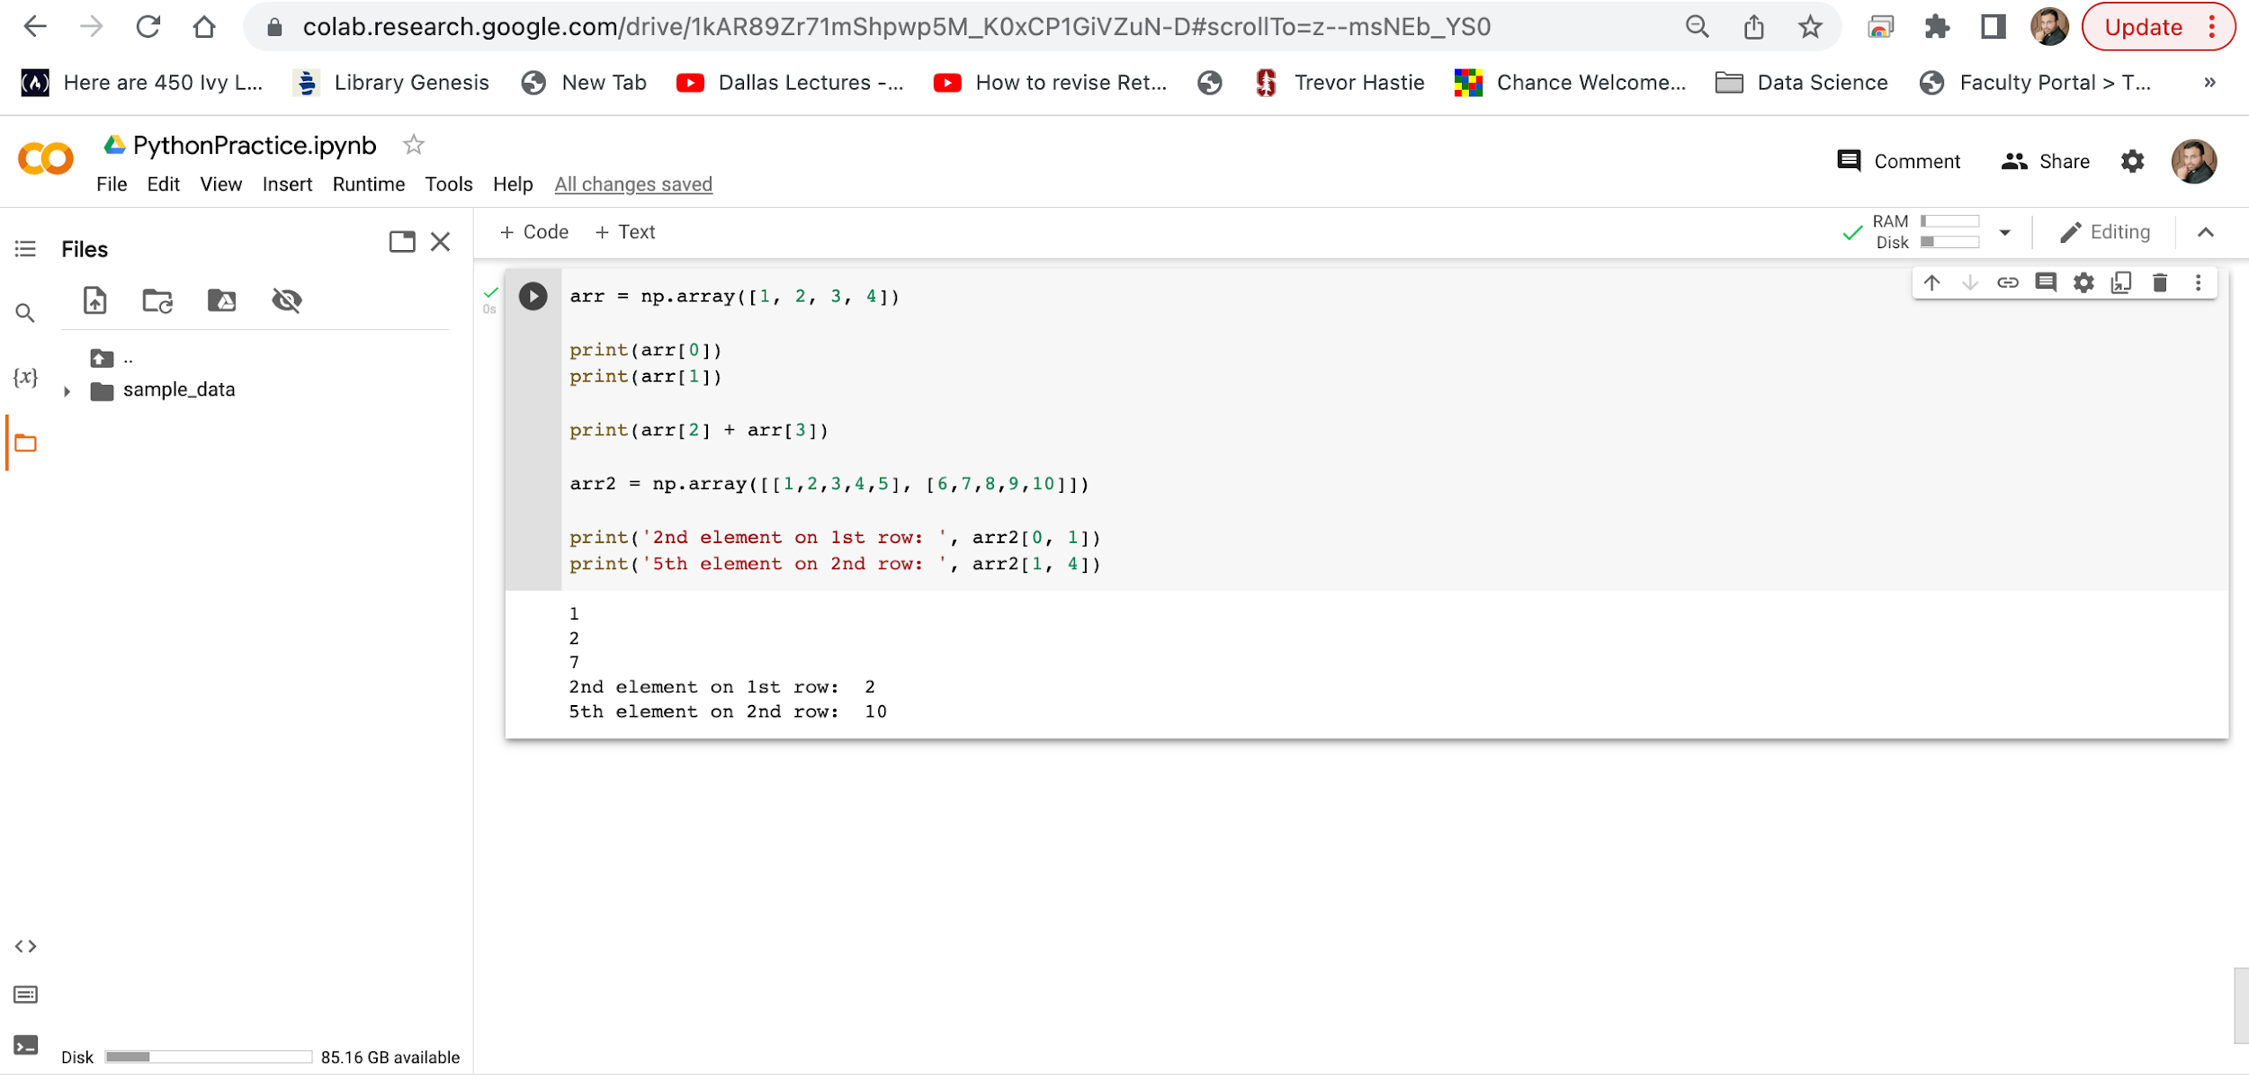
Google Colab

Slide 22
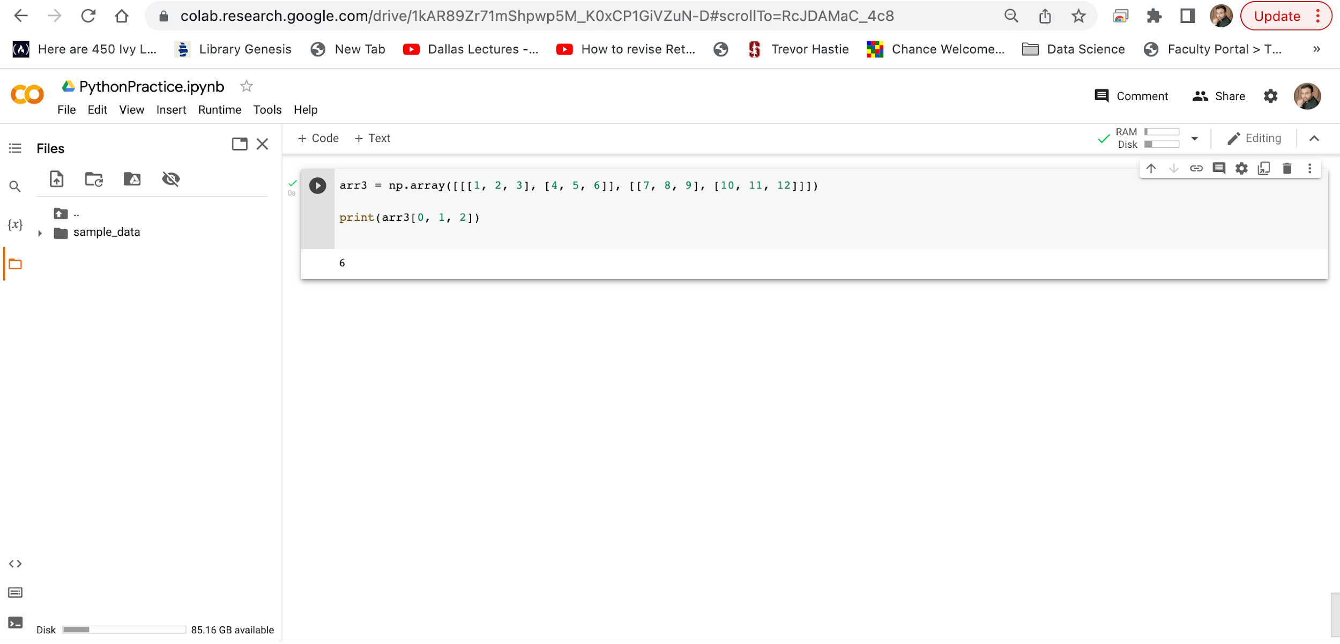
Google Colab
arr3[0, 1, 2] prints the value 6.
And this is why:
The first number represents the first dimension, which contains two arrays: [[1, 2, 3], [4, 5, 6]] and: [[7, 8, 9], [10, 11, 12]] Since we selected 0, we are left with the first array: [[1, 2, 3], [4, 5, 6]]
The second number represents the second dimension, which also contains two arrays: [1, 2, 3] and: [4, 5, 6] Since we selected 1, we are left with the second array: [4, 5, 6]
The third number represents the third dimension, which contains three values: 4 5 6 Since we selected 2, we end up with the third value: 6

Slide 23
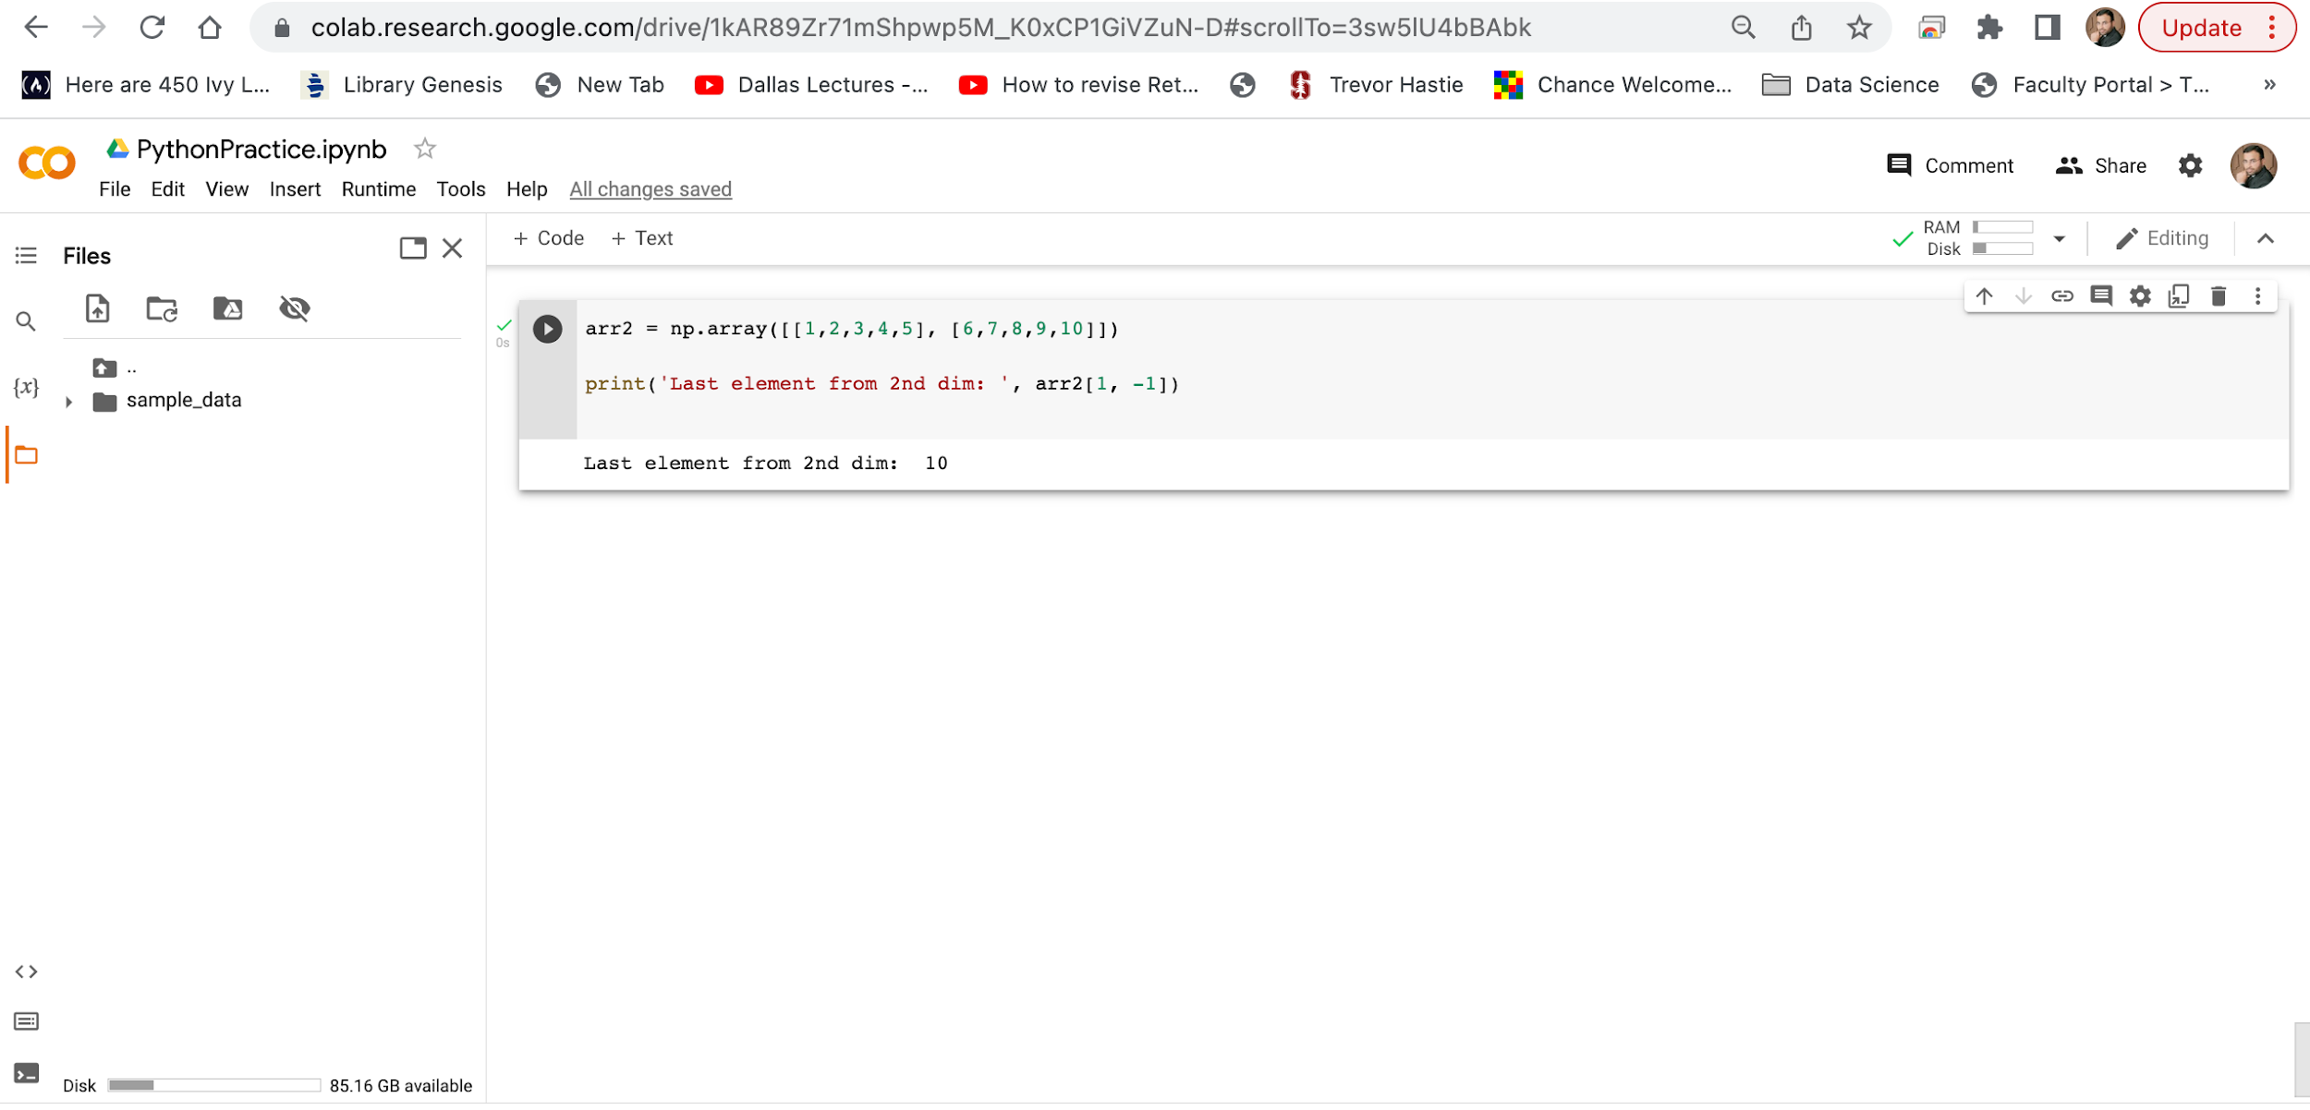
Google Colab
Negative Indexing
Use negative indexing to access an array from the end.
Example
Print the last element from the 2nd dim

Slide 24
Google Colab
Slicing arrays
Slicing in python means taking elements from one given index to another given index.
We pass slice instead of index like this: [start:end].
We can also define the step, like this: [start:end:step].
If we don't pass start its considered 0
If we don't pass end its considered length of array in that dimension
If we don't pass step its considered 1.
The result includes the start index, but excludes the end index.
Negative Slicing
Use the minus operator to refer to an index from the end.

Slide 25
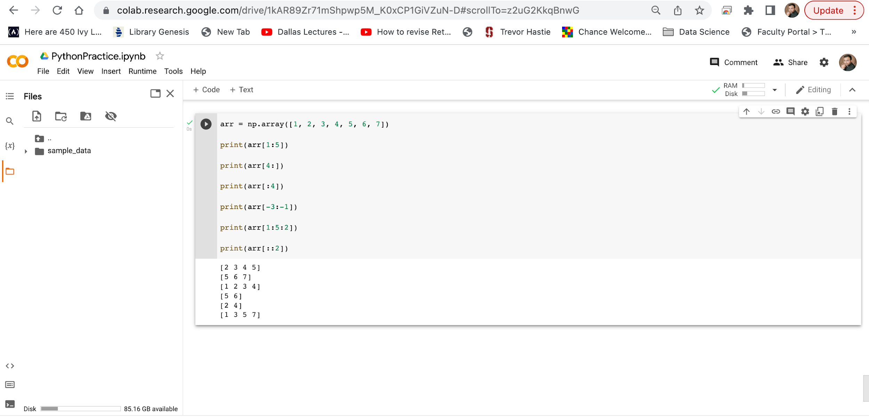
Google Colab
Slice elements from index 1 to index 5 from the following array.
Slice elements from index 4 to the end of the array.
Slice elements from the beginning to index 4 (not included).
Slice from the index 3 from the end to index 1 from the end.
Return every other element from index 1 to index 5.
Return every other element from the entire array.

Slide 26
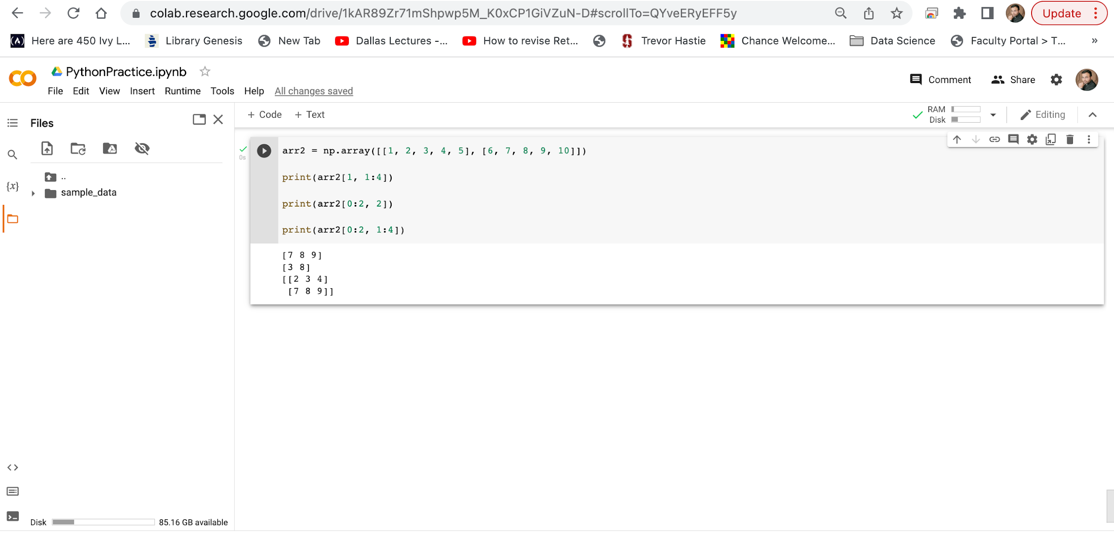
Google Colab
arr2 is a 2 dimensional Array having 2 1- D Arrays.
At 0 index we have 1-D array [1, 2, 3, 4, 5] and
At 1 index we have array [6, 7, 8, 9, 10]
In this code arr2[1, 1:4], first value 1 means From the 2-D Array arr2 select the second 1-D Array, [6, 7, 8, 9, 10] and second value 1:4 in the code means slice elements from index 1 to index 4 (not included) of selected Array. Means [6 7 8]
In this code arr2[0:2, 2], first value 0:2 means among the both Arrays of 2-D Array [1, 2, 3, 4, 5], [6, 7, 8, 9, 10] select both. Second value 2 in the code means slice only 1 element of index 2 from both Arrays. Means 3 elements is at index 2 of Array [1, 2, 3, 4, 5] and 8 is at index 2 of second Array [6, 7, 8, 9, 10] so result is two elements 1-D Array.
[3 8]
In this code arr2[0:2, 1:4], first value 0:2 means From the both elements of 2-D Array [1, 2, 3, 4, 5], [6, 7, 8, 9, 10]. Second value 1:4 in the code means from both Arrays, slice index 1 to index 4 (not included), this will return a 2-D array. From this Array [1, 2, 3, 4, 5]
1:4 slicing would sice value [2 3 4] and from this array [6, 7, 8, 9, 10] 1:4 slicing would slice value [7 8 9] so result is 2-D array [[2 3 4] [7 8 9]]

Slide 27
Google Colab
Data Types in Python
By default Python have these data types:
strings - used to represent text data, the text is given under quote marks. e.g. "ABCD"
integer - used to represent integer numbers. e.g. -1, -2, -3
float - used to represent real numbers. e.g. 1.2, 42.42
boolean - used to represent True or False.
complex - used to represent complex numbers. e.g. 1.0 + 2.0j, 1.5 + 2.5j

Slide 28
Google Colab
Data Types in NumPy
NumPy has some extra data types, and refer to data types with one character, like i for integers, u for unsigned integers etc.
Below is a list of all data types in NumPy and the characters used to represent them.
i - integer
b - boolean
u - unsigned integer
f - float
c - complex float
m - timedelta
M - datetime
O - object
S - string
U - unicode string
V - fixed chunk of memory for other type ( void )

Slide 29
Google Colab
Data Types in NumPy
Checking the Data Type of an Array
The NumPy array object has a property called dtype that returns the data type of the array.

Slide 30
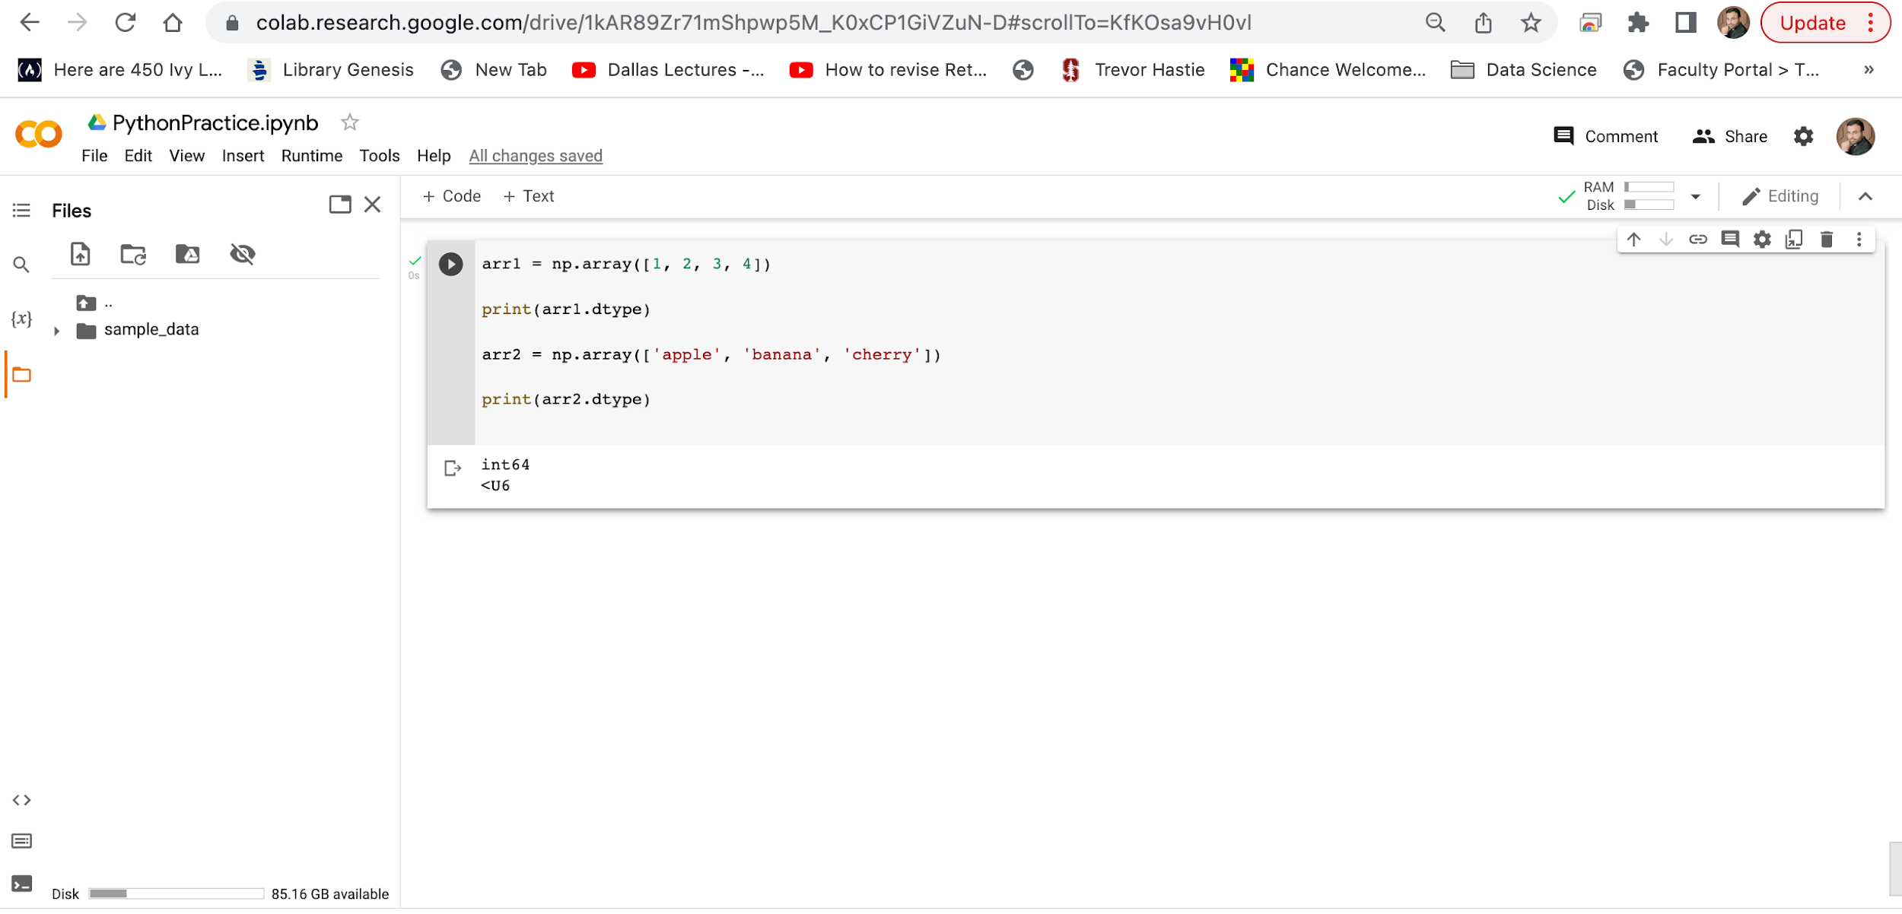
Google Colab

Slide 31
Google Colab
Data Types in NumPy
Creating Arrays With a Defined Data Type
We use the array() function to create arrays, this function can take an optional argument: dtype that allows us to define the expected data type of the array elements.

Slide 32
Google Colab
Data Types in NumPy
What if a Value Can Not Be Converted?
If a type is given in which elements can't be casted then NumPy will raise a ValueError.
ValueError: In Python ValueError is raised when the type of passed argument to a function is unexpected/incorrect.

Slide 33
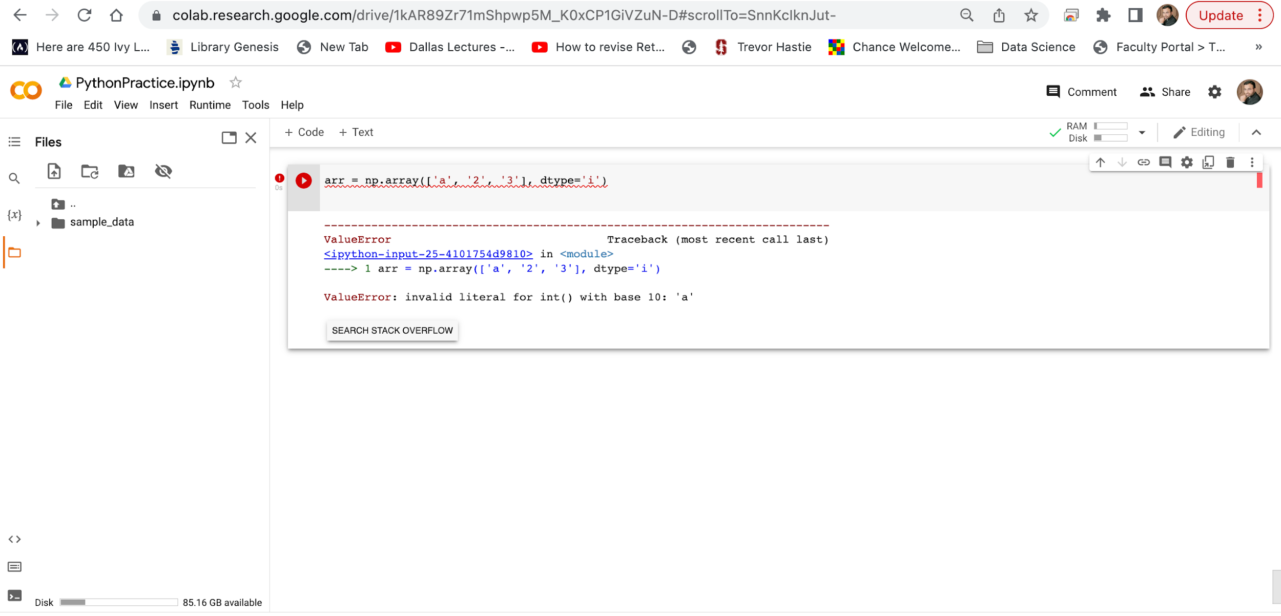
Google Colab

Slide 34
Google Colab
Data Types in NumPy
Converting Data Type on Existing Arrays
The best way to change the data type of an existing array, is to make a copy of the array with the astype() method.
The astype() function creates a copy of the array, and allows you to specify the data type as a parameter.
The data type can be specified using a string, like 'f' for float, 'i' for integer etc. or you can use the data type directly like float for float and int for integer.

Slide 35
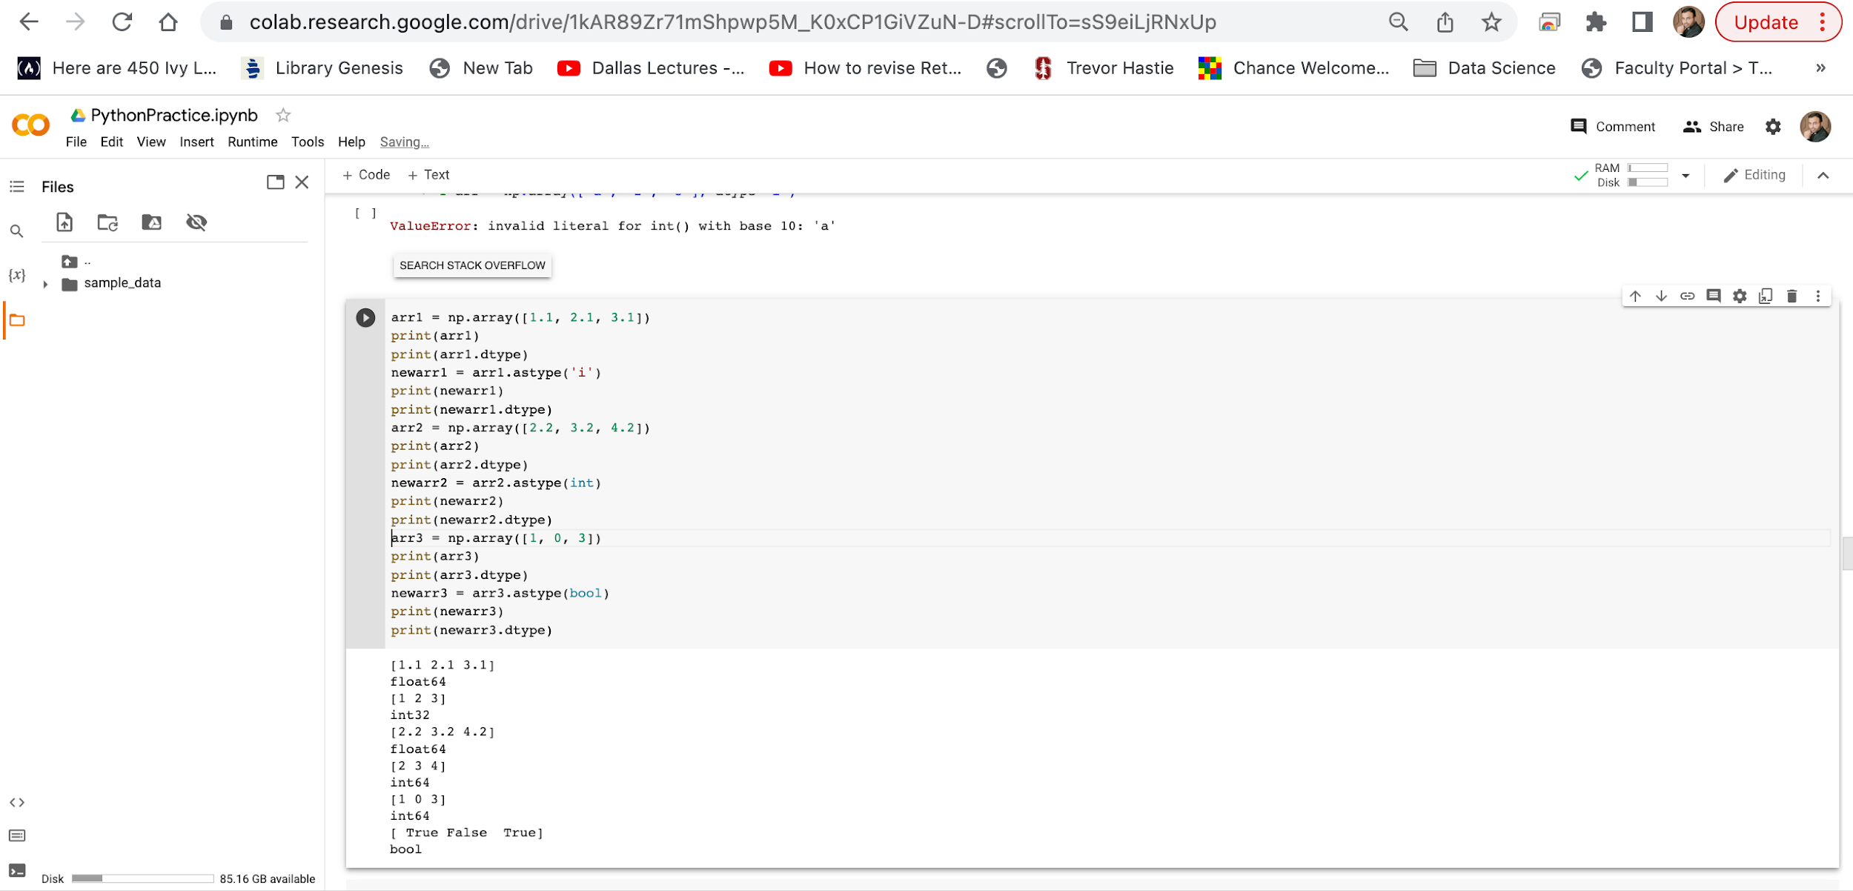
Google Colab

Slide 36
Google Colab
Data Types in NumPy
NumPy Array Copy vs View
The Difference Between Copy and View
The main difference between a copy and a view of an array is that the copy is a new array, and the view is just a view of the original array.
The copy owns the data and any changes made to the copy will not affect original array, and any changes made to the original array will not affect the copy.
The view does not own the data and any changes made to the view will affect the original array, and any changes made to the original array will affect the view.

Slide 37
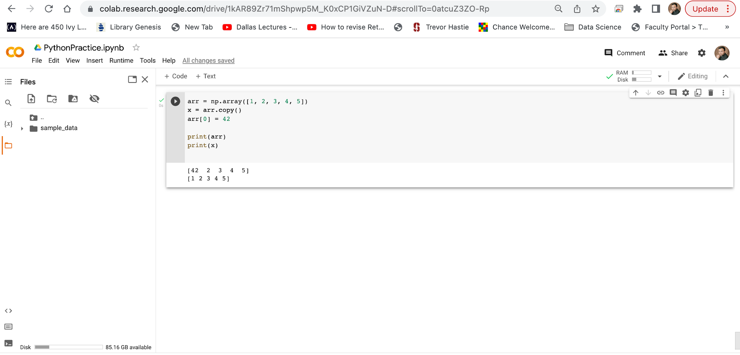
Google Colab

Slide 38
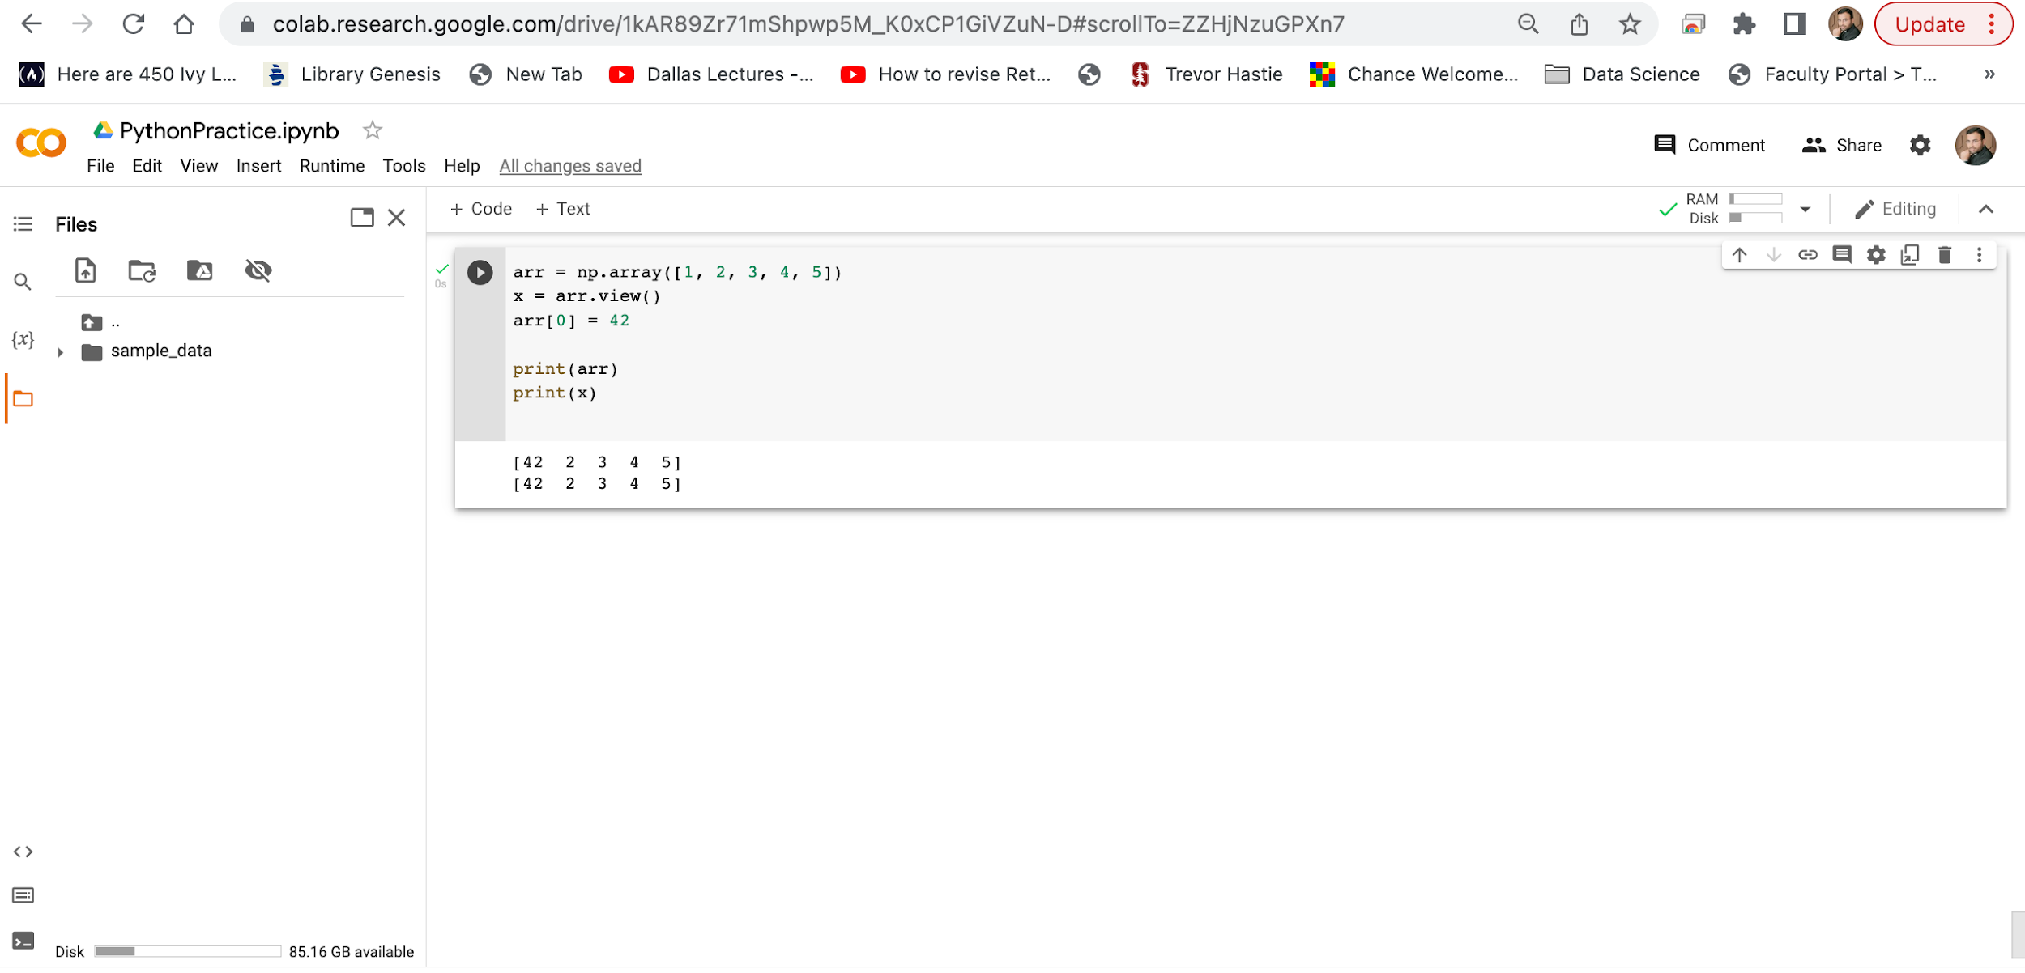
Google Colab

Slide 39
Google Colab
Data Types in NumPy
NumPy Array Copy vs View
Check if Array Owns its Data
As mentioned above, copies owns the data, and views does not own the data, but how can we check this?
Every NumPy array has the attribute base that returns None if the array owns the data.
Otherwise, the base attribute refers to the original object.

Slide 40
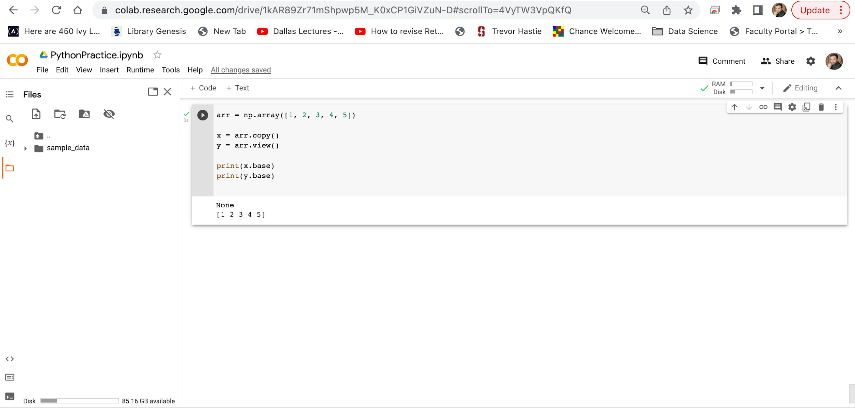
Google Colab
The copy returns None.
The view returns the original array.

Slide 41
Google Colab
NumPy Array Shape
Shape of an Array
The shape of an array is the number of elements in each dimension.
Get the Shape of an Array
NumPy arrays have an attribute called shape that returns a tuple with each index having the number of corresponding elements.

Slide 42
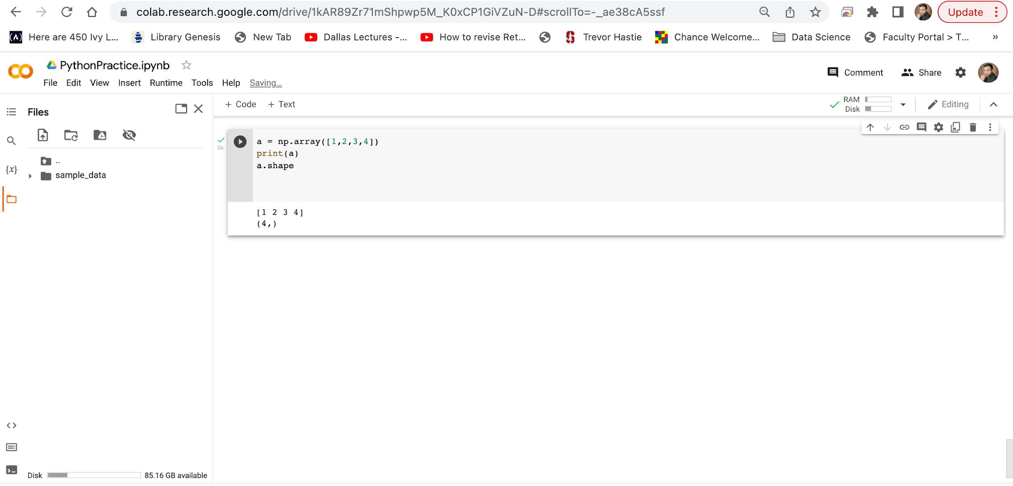
Google Colab

Slide 43
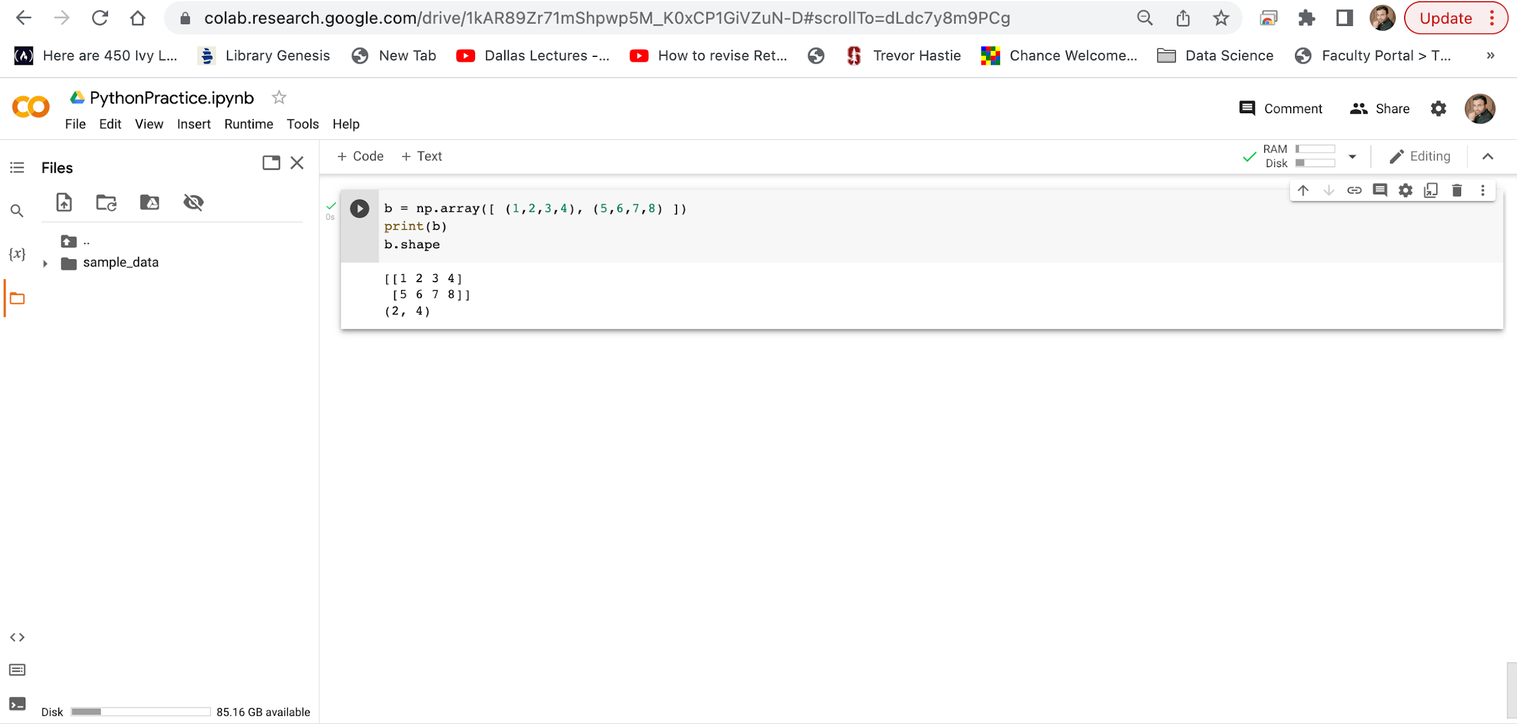
Google Colab
Created an array 2-D of data type int.
The shape returns (2, 4), which means that the array has 2 dimensions, where the first dimension has 2 elements and the second has 4.

Slide 44
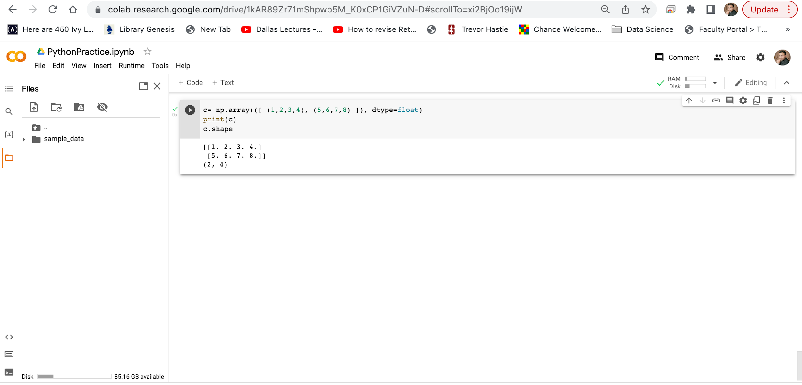
Google Colab
Created an array 2-D using tuple of data type float.
The shape returns (2, 4), which means that the array has 2 dimensions, where the first dimension has 2 elements and the second has 4.

Slide 45
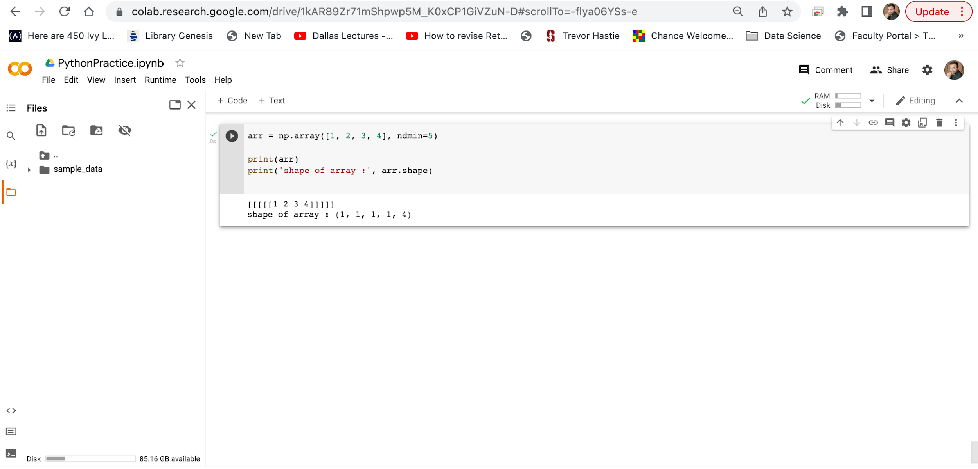
Google Colab
Created an array 5-D of data type int.
Here at index-4 we have value 4, so we can say that 5th ( 4 + 1 th) dimension has 4 elements.

Slide 46
Google Colab
NumPy Array Shape
Shape of an Array
What does the shape tuple represent?
Integers at every index tells about the number of elements the corresponding dimension has.

Slide 47
Google Colab
NumPy Array Reshaping
Reshaping arrays
Reshaping means changing the shape of an array.
The shape of an array is the number of elements in each dimension.
By reshaping we can add or remove dimensions or change number of elements in each dimension.

Slide 48
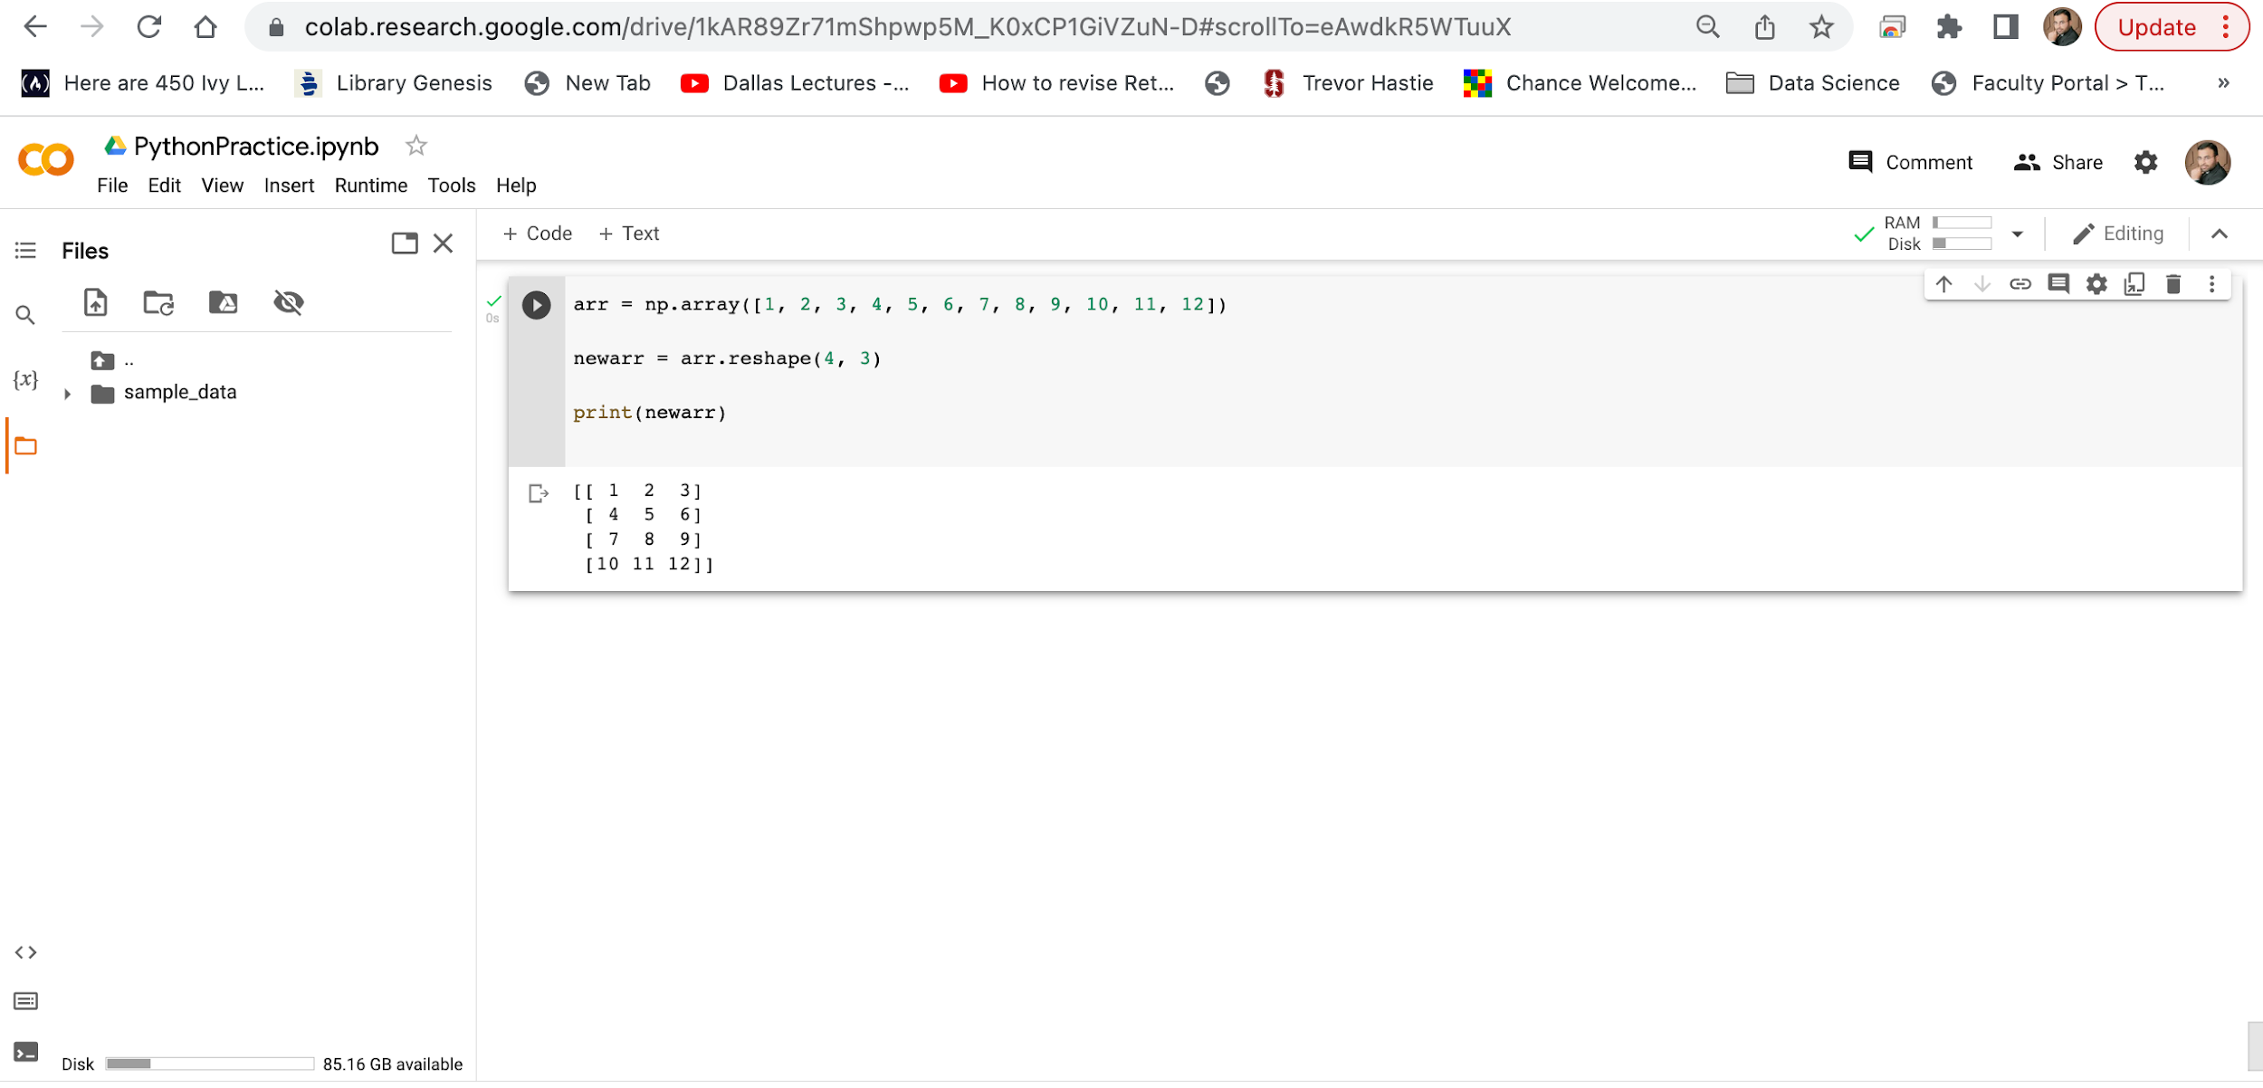
Google Colab
Convert the 1-D array with 12 elements into a 2-D array.
The outermost dimension will have 4 arrays, each with 3 elements:

Slide 49
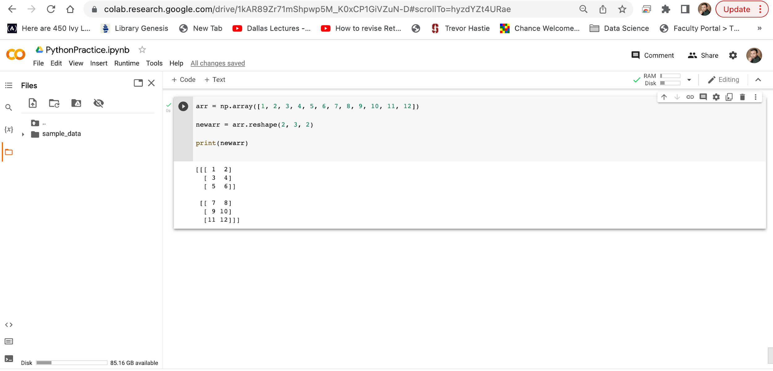
Google Colab
Convert the 1-D array with 12 elements into a 2-D array.
The outermost dimension will have 2 arrays that contains 3 arrays, each with 2 elements:

Slide 50
Google Colab
NumPy Array Reshaping
Can We Reshape Into any Shape?
Yes, as long as the elements required for reshaping are equal in both shapes.
We can reshape an 8 elements 1D array into 4 elements in 2 rows 2D array but we cannot reshape it into a 3 elements 3 rows 2D array as that would require 3x3 = 9 elements.

Slide 51
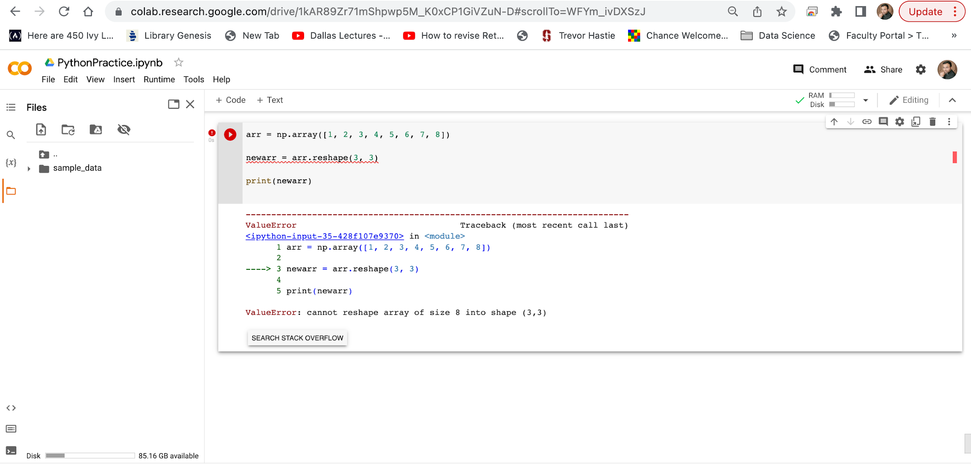
Google Colab

Slide 52
Google Colab
NumPy Array Reshaping
Returns Copy or View?
Check if the returned array is a copy or a view:
The example below returns the original array, so it is a view.

Slide 53
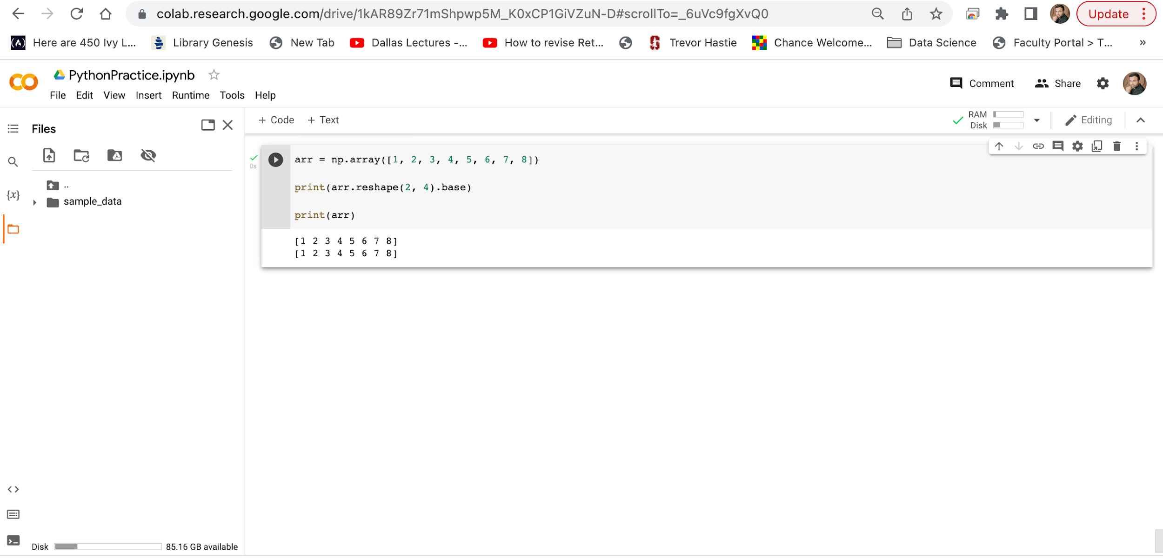
Google Colab

Slide 54
Google Colab
NumPy Array Reshaping
Unknown Dimension
You are allowed to have one "unknown" dimension.
Meaning that you do not have to specify an exact number for one of the dimensions in the reshape method.
Pass -1 as the value, and NumPy will calculate this number for you.

Slide 55
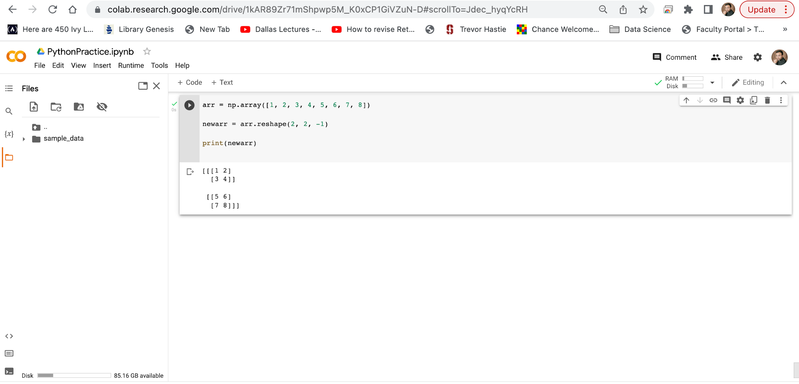
Google Colab
Convert 1D array with 8 elements to 3D array with 2x2 elements.
We can not pass -1 to more than one dimension.

Slide 56
Google Colab
NumPy Array Reshaping
Flattening the arrays
Flattening array means converting a multidimensional array into a 1D array.
We can use reshape(-1) to do this.
There are a lot of functions for changing the shapes of arrays in numpy flatten, ravel and also for rearranging the elements rot90, flip, fliplr, flipud etc.

Slide 57
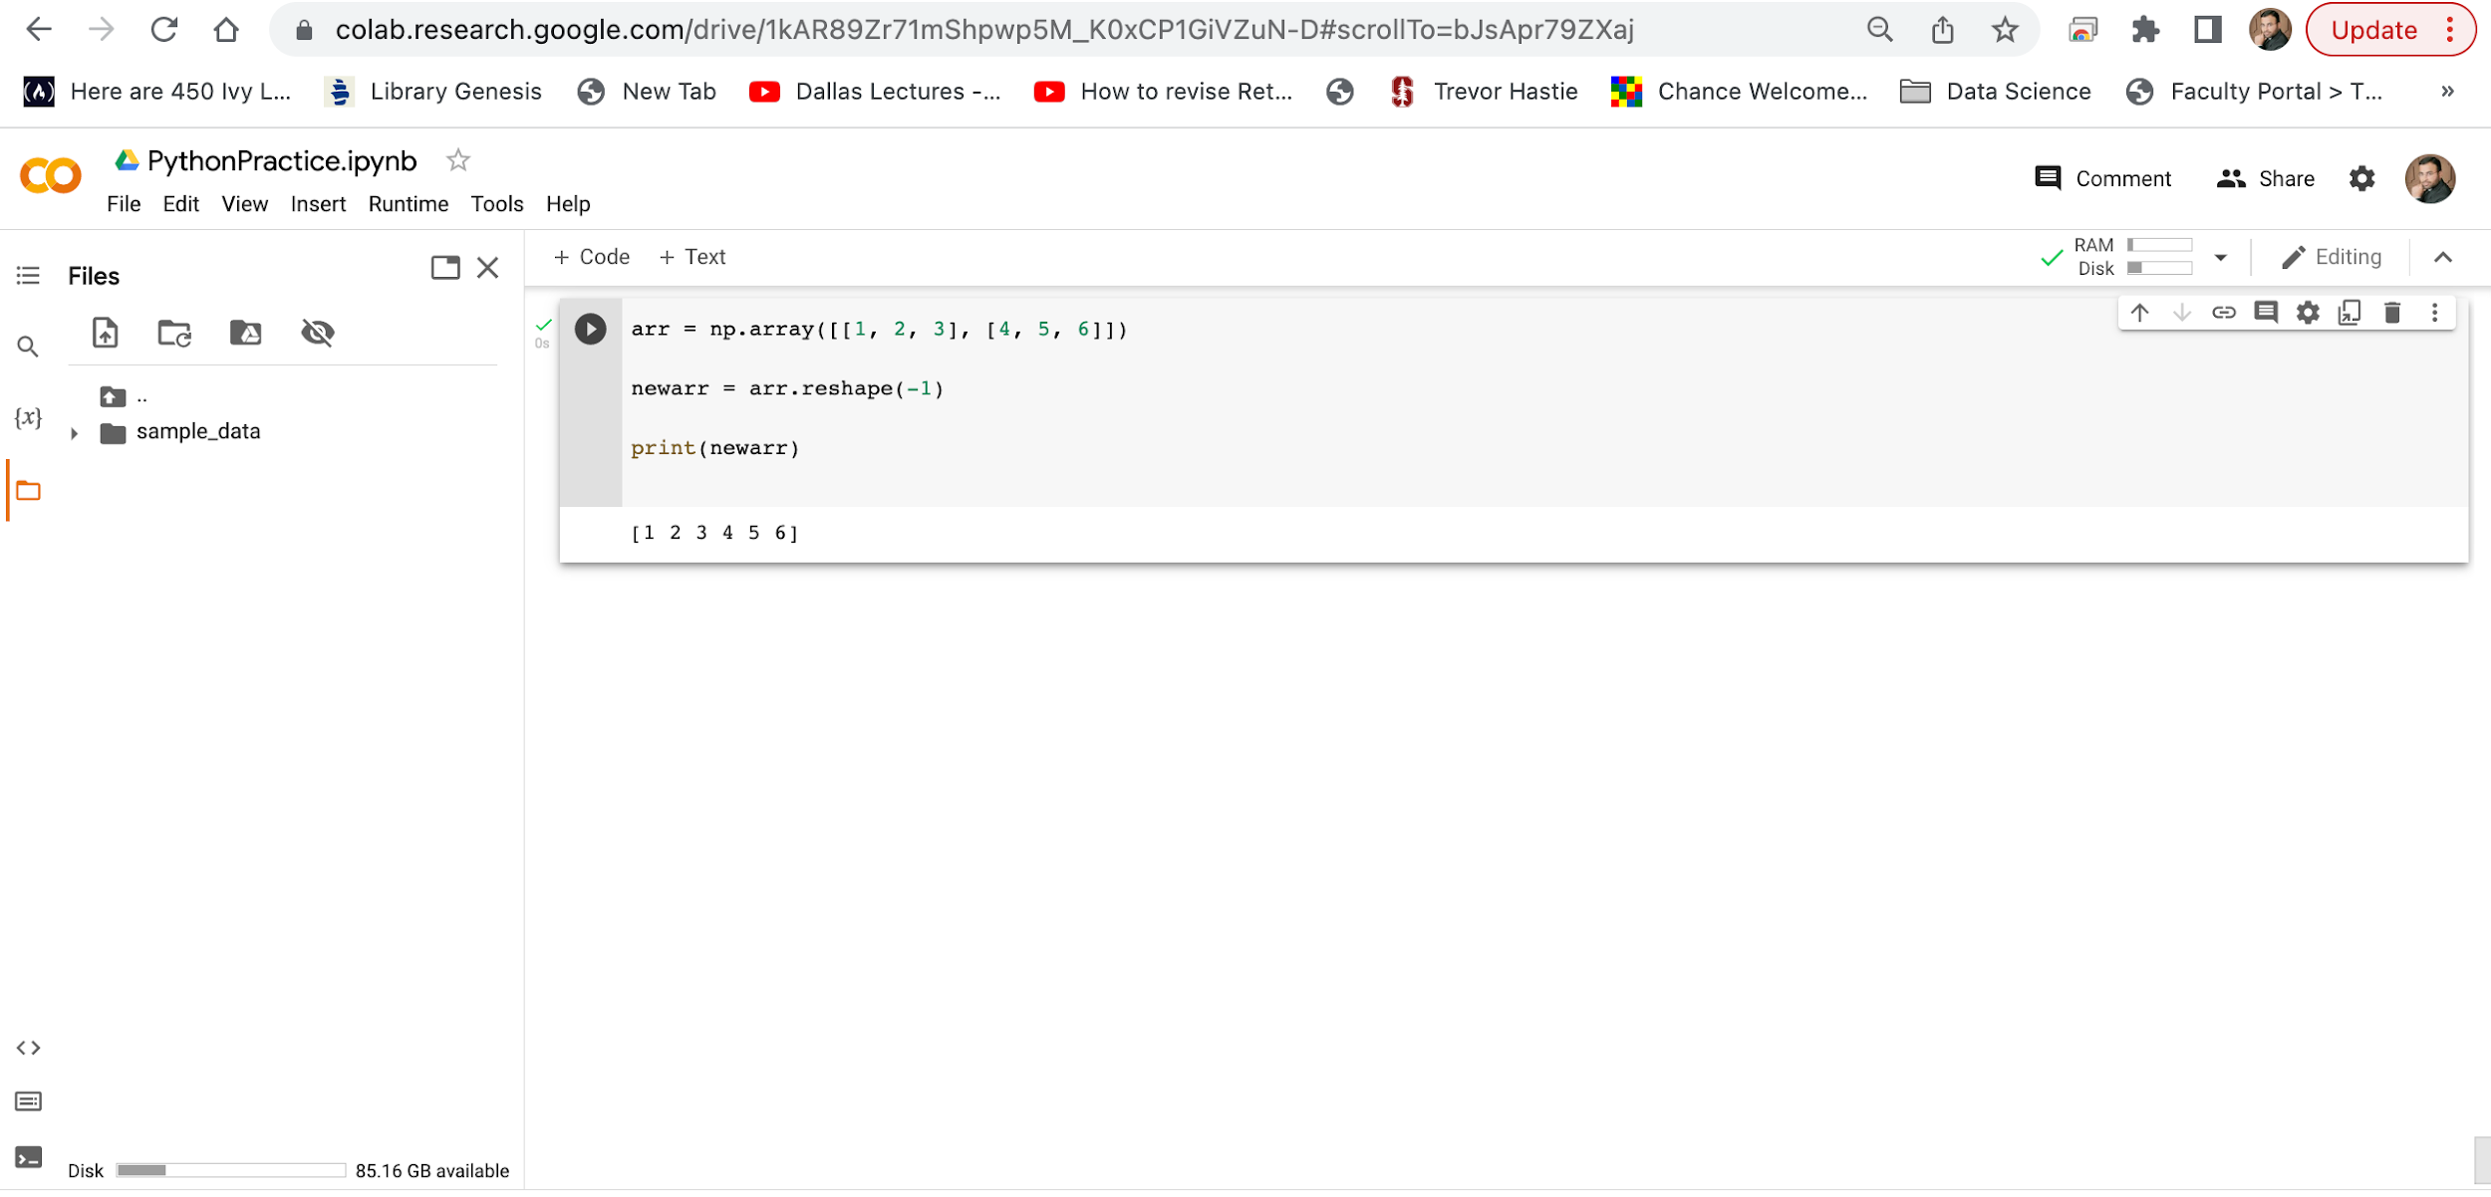
Google Colab

Slide 58
Google Colab
NumPy Array Iterating
Iterating means going through elements one by one.
As we deal with multi-dimensional arrays in numpy, we can do this using basic for loop of python.
If we iterate on a 1-D array it will go through each element one by one.
In a 2-D array it will go through all the rows.
If we iterate on a n-D array it will go through n-1th dimension one by one.
To return the actual values, the scalars, we have to iterate the arrays in each dimension.

Slide 59
Google Colab
NumPy Array Iterating
Iterating Arrays Using nditer()
The function nditer() is a helping function that can be used from very basic to very advanced iterations. It solves some basic issues which we face in iteration, lets go through it with examples.
Iterating on Each Scalar Element
In basic for loops, iterating through each scalar of an array we need to use n for loops which can be difficult to write for arrays with very high dimensionality.

Slide 60
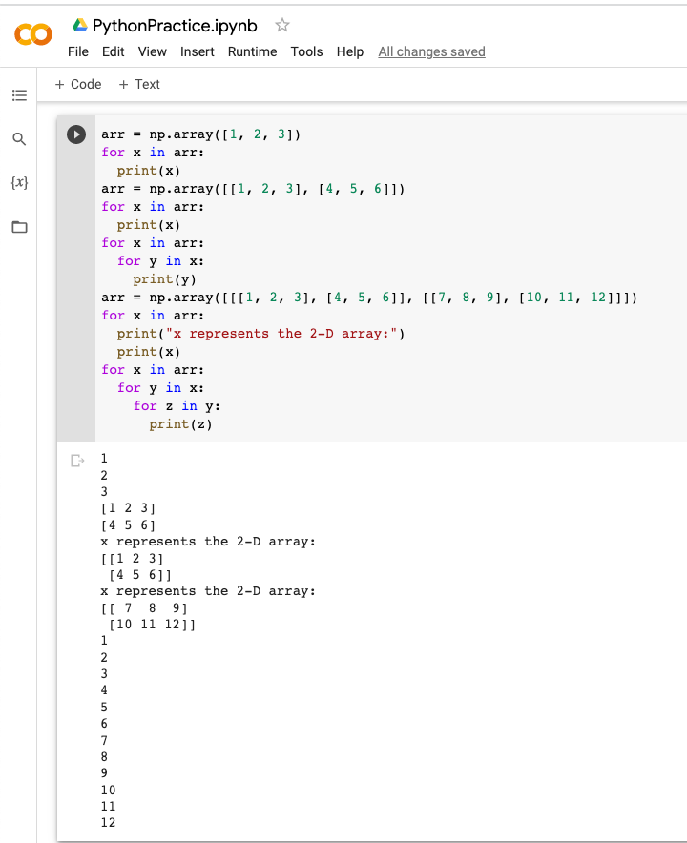
Google Colab
Iterate on the elements of the following 1-D array.
Iterate on the elements of the following 2-D array.
Iterate on each scalar element of the 2-D array.
In a 3-D array it will go through all the 2-D arrays.
To return the actual values, the scalars, we have to iterate the arrays in each dimension. Iterate down to the scalars.

Slide 61
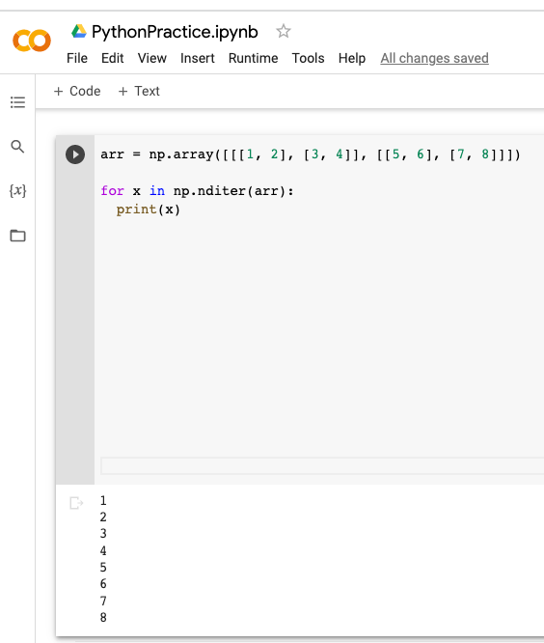
Google Colab
Iterate through the following 3-D array.

Slide 62
Google Colab
NumPy Array Iterating
Iterating Array With Different Data Types
We can use op_dtypes argument and pass it the expected datatype to change the datatype of elements while iterating.
NumPy does not change the data type of the element in-place (where the element is in array) so it needs some other space to perform this action, that extra space is called buffer, and in order to enable it in nditer() we pass flags=['buffered'].

Slide 63
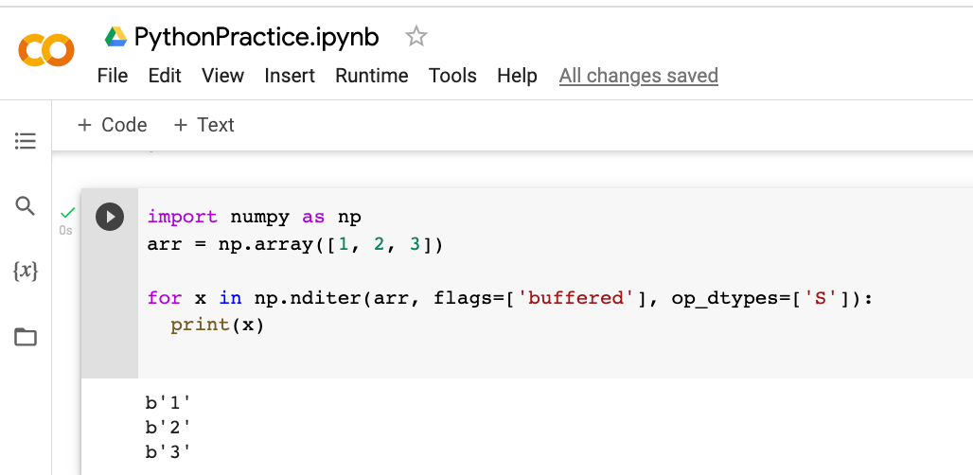
Google Colab
Iterate through the following 3-D array.

Slide 64
Google Colab
NumPy Array Iterating
Enumerated Iteration Using ndenumerate()
Enumeration means mentioning sequence number of somethings one by one.
Sometimes we require corresponding index of the element while iterating, the ndenumerate() method can be used for those usecases.

Slide 65
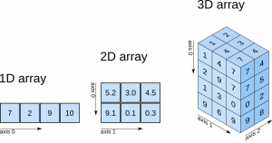
Google Colab

Slide 66
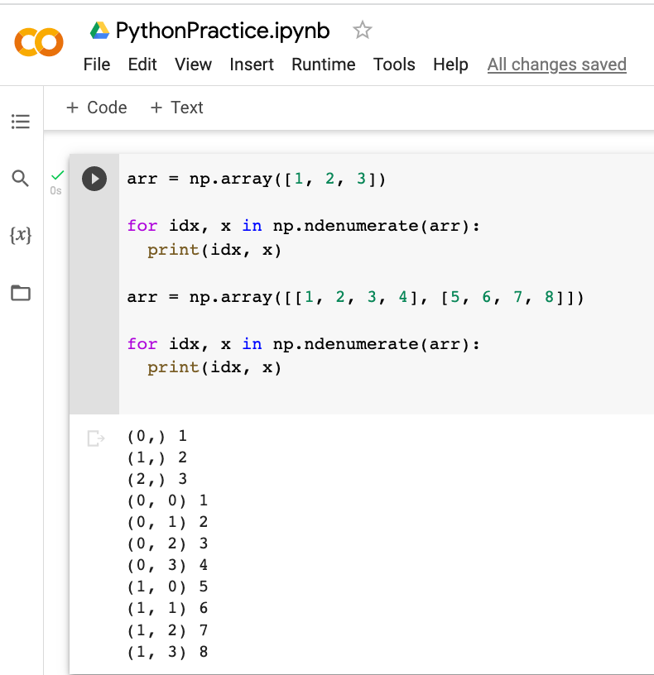
Google Colab

Slide 67
Google Colab
Joining NumPy Arrays
Joining means putting contents of two or more arrays in a single array.
In SQL we join tables based on a key, whereas in NumPy we join arrays by axes.
We pass a sequence of arrays that we want to join to the concatenate() function, along with the axis. If axis is not explicitly passed, it is taken as 0.

Slide 68
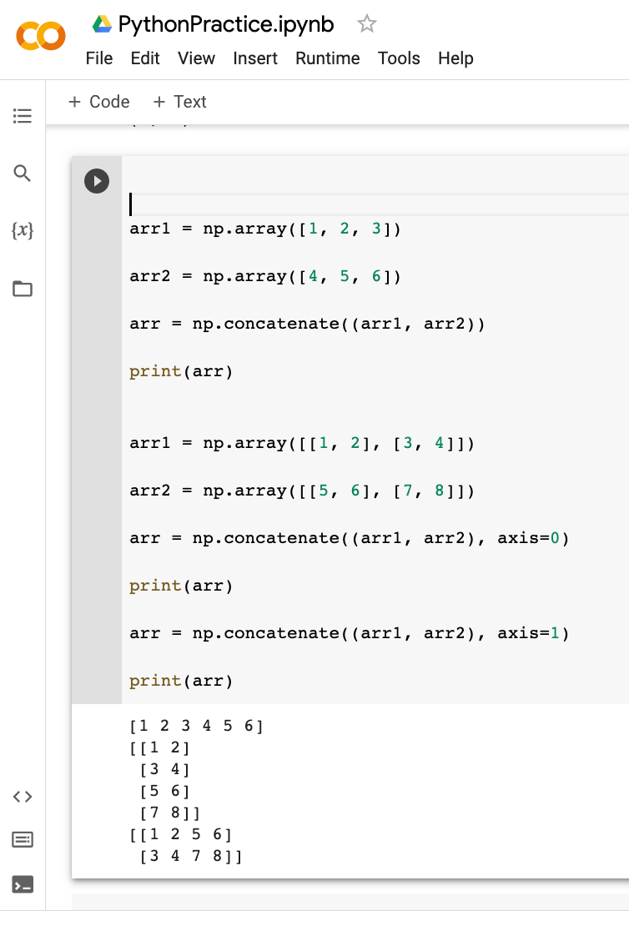
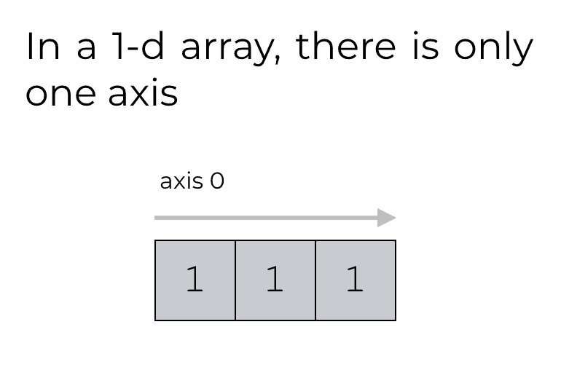
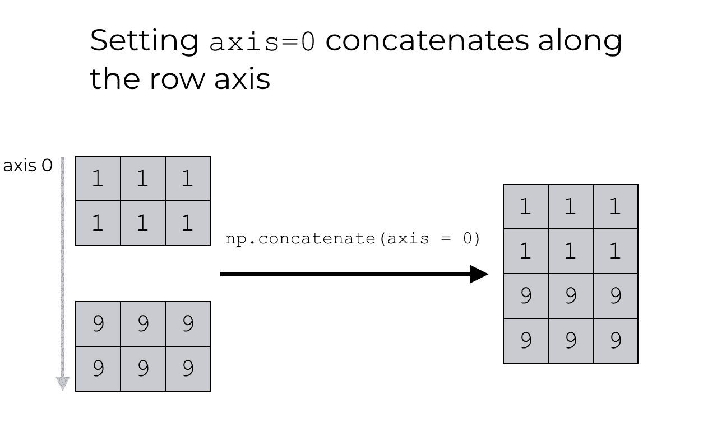
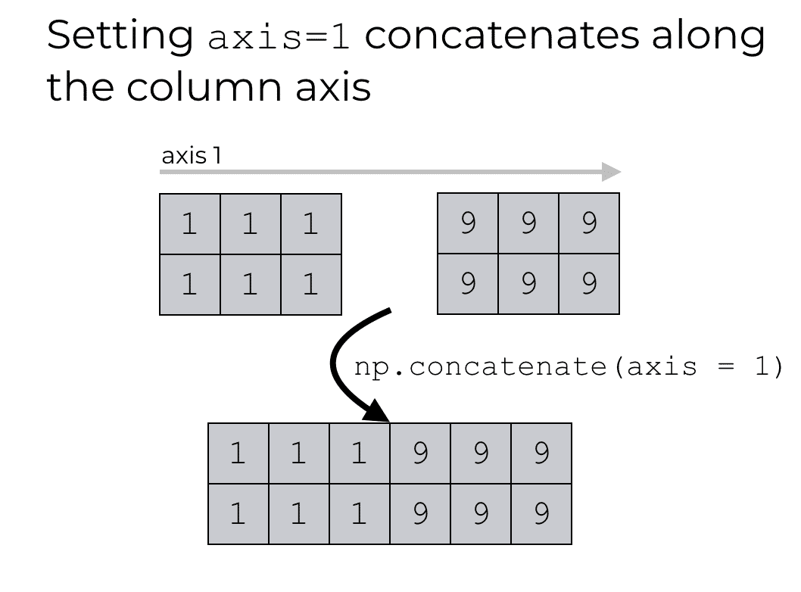
Google Colab
Join two 1-D arrays
Join two 2-D arrays along rows (axis=0).
Join two 2-D arrays along columns (axis=1).

Slide 69
Google Colab
Joining NumPy Arrays
Joining Arrays Using Stack Functions
Stacking is same as concatenation, the only difference is that stacking is done along a new axis.
We can concatenate two 1-D arrays along the second axis which would result in putting them one over the other, ie. stacking.
We pass a sequence of arrays that we want to join to the stack() method along with the axis. If axis is not explicitly passed it is taken as 0.

Slide 70
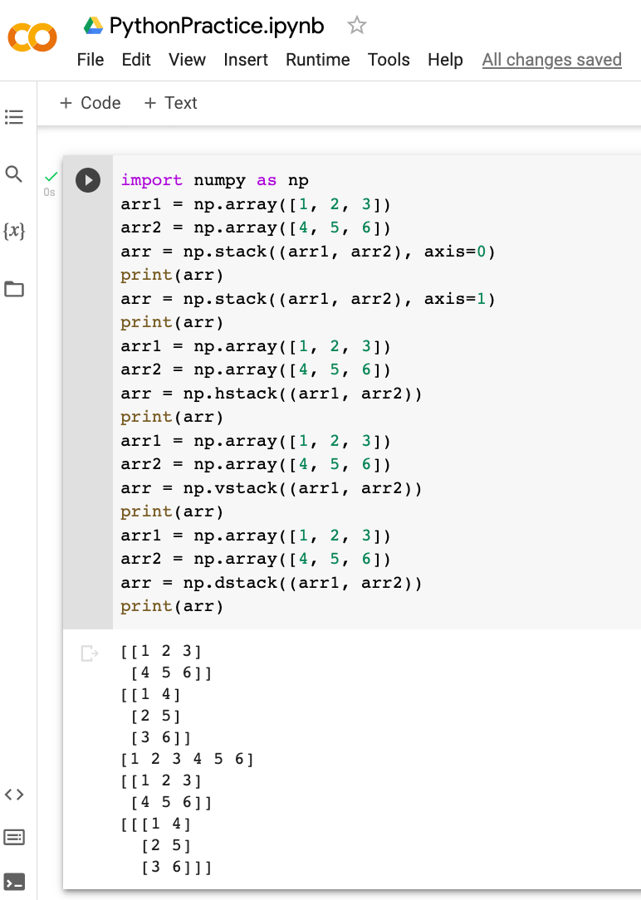
Google Colab
NumPy provides a helper function: hstack() to stack along rows.
NumPy provides a helper function: vstack() to stack along columns.
NumPy provides a helper function: dstack() to stack along height, which is the same as depth.

Slide 71
Google Colab
NumPy Splitting Array
Splitting is reverse operation of Joining.
Joining merges multiple arrays into one and Splitting breaks one array into multiple.
We use array_split() for splitting arrays, we pass it the array we want to split and the number of splits.
Split Into Arrays
The return value of the array_split() method is an array containing each of the split as an array.

Slide 72
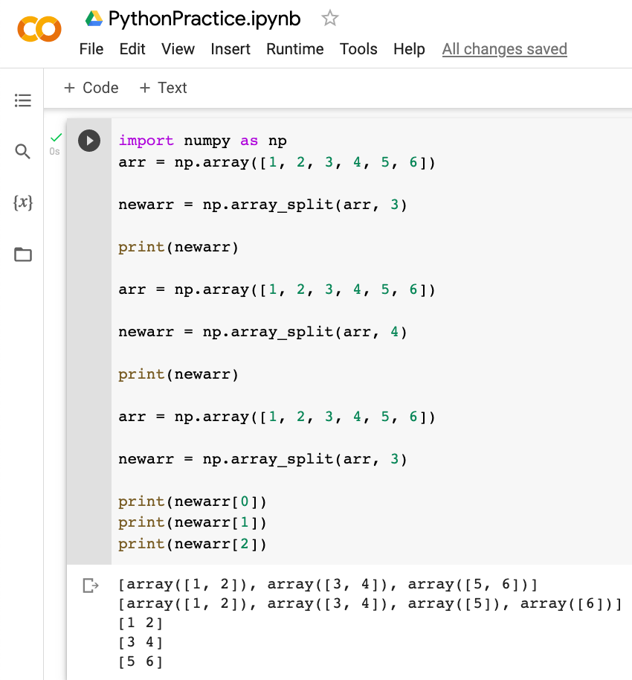
Google Colab
array_ split The return value is an array containing three arrays.
If the array has less elements than required, it will adjust from the end accordingly.
If you split an array into 3 arrays, you can access them from the result just like any array element with index.

Slide 73
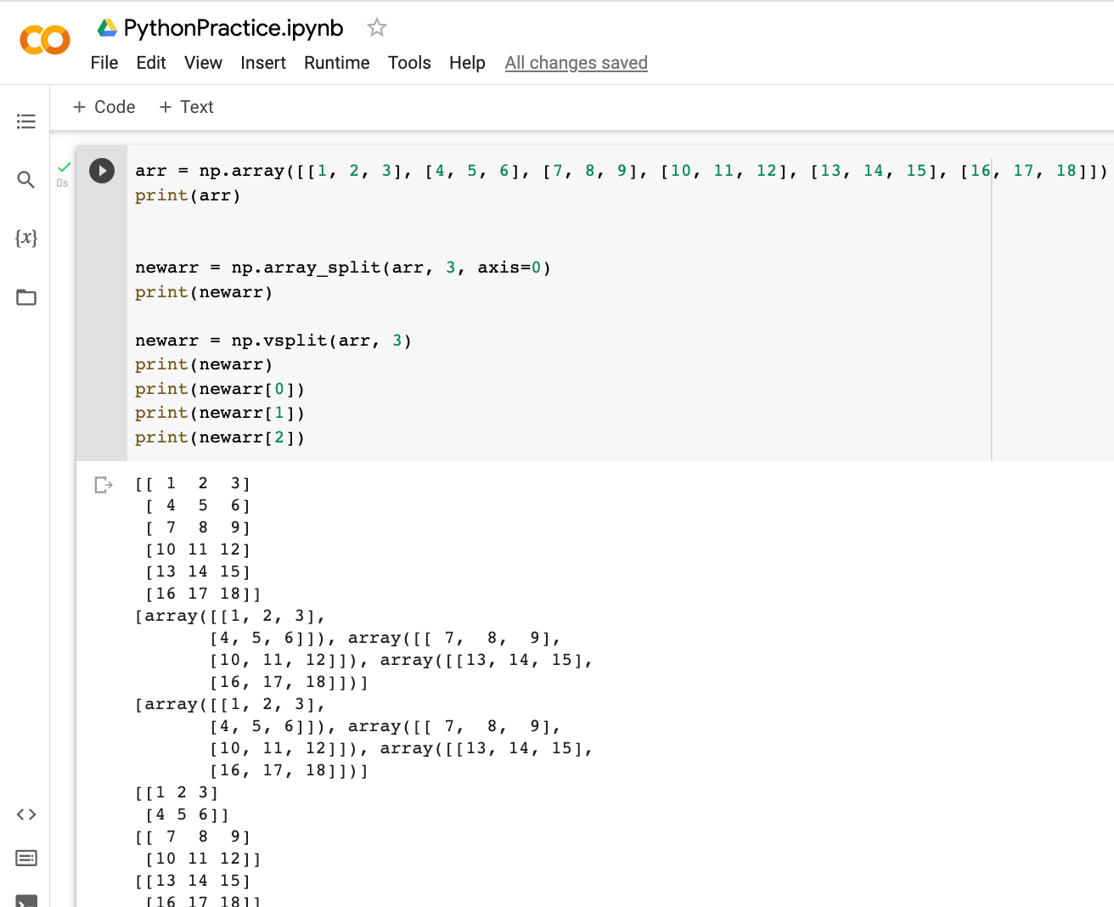
Google Colab

Slide 74
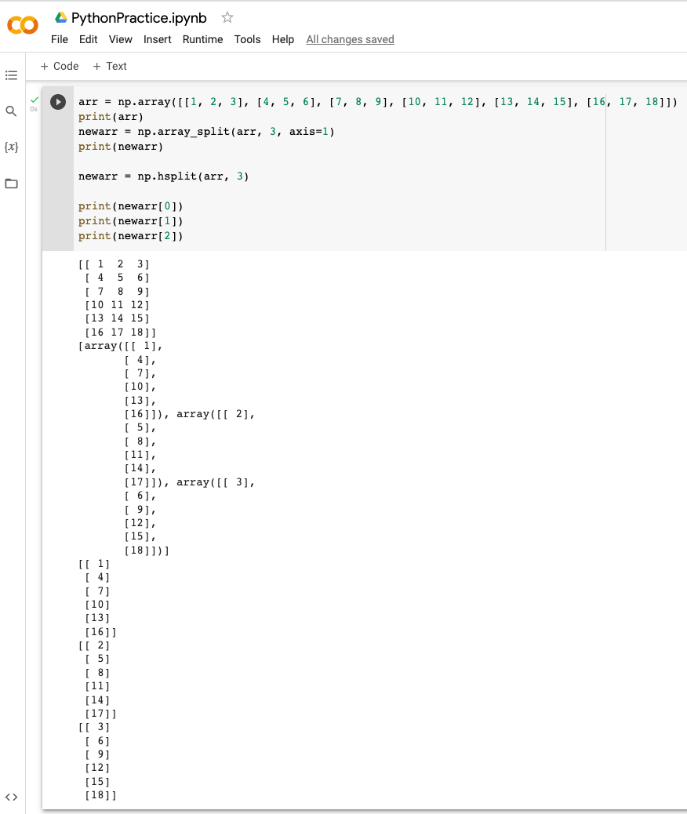
Google Colab

Slide 75
Google Colab
Sorting Arrays
Sorting means putting elements in an ordered sequence.
Ordered sequence is any sequence that has an order corresponding to elements, like numeric or alphabetical, ascending or descending.
The NumPy ndarray object has a function called sort(), that will sort a specified array.

Slide 76
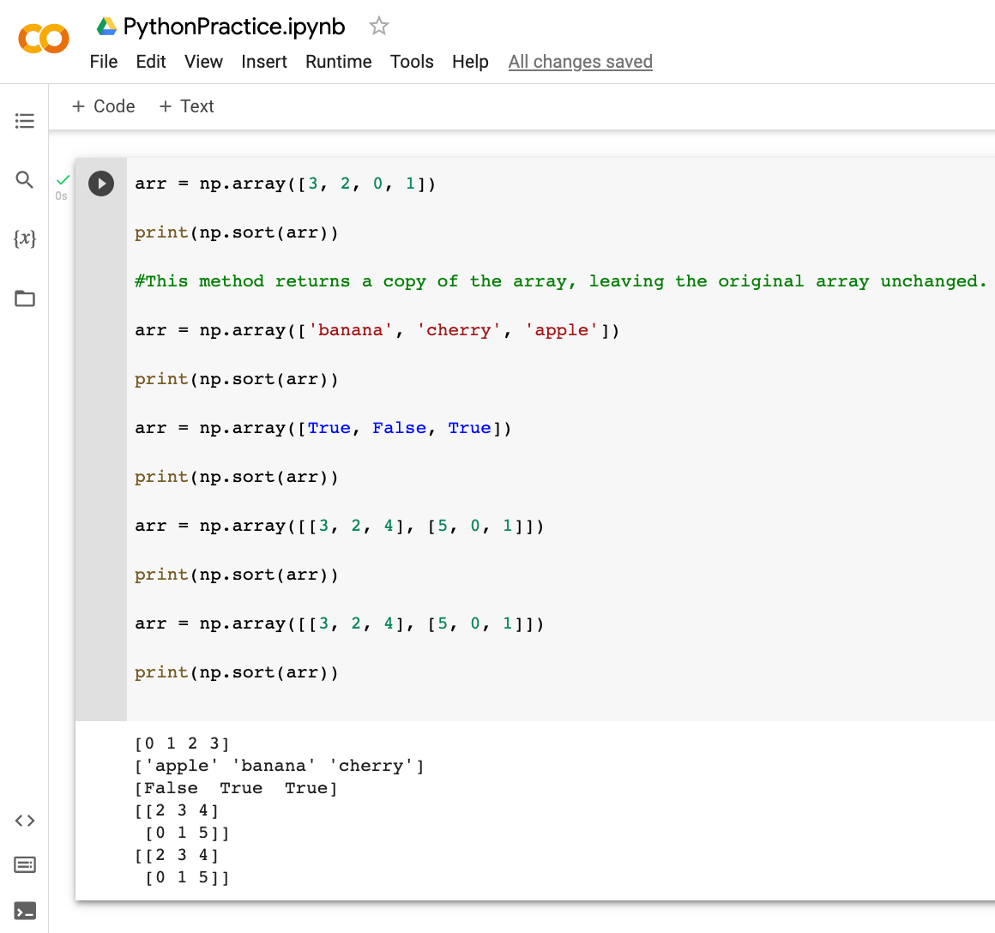
Google Colab

Slide 77
Google Colab
NumPy Searching Arrays
You can search an array for a certain value, and return the indexes that get a match.
To search an array, use the where() method.
Search Sorted
There is a method called searchsorted() which performs a binary search in the array, and returns the index where the specified value would be inserted to maintain the search order.
The searchsorted() method is assumed to be used on sorted arrays.

Slide 78
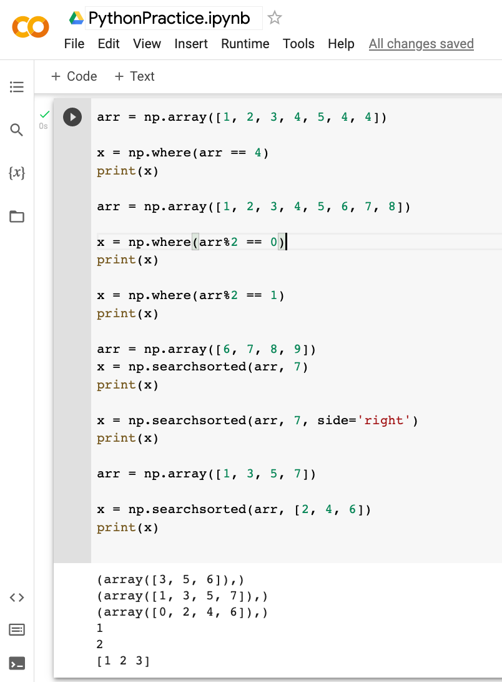
Google Colab
The example above will return a tuple: (array([3, 5, 6],)
Which means that the value 4 is present at index 3, 5, and 6.
Find the indexes where the values are even.
Find the indexes where the values are odd.
Find the indexes where the value 7 should be inserted. The number 7 should be inserted on index 1 to remain the sort order. The method starts the search from the left and returns the first index where the number 7 is no longer larger than the next value.
Find the indexes where the value 7 should be inserted. This works from right to left. The number 7 should be inserted on index 2 to remain the sort order. The method starts the search from the right and returns the first index where the number 7 is no longer less than the next value.
The return value is an array: [1 2 3] containing the three indexes where 2, 4, 6 would be inserted in the original array to maintain the order.

Slide 79
Google Colab
Filtering Arrays
Getting some elements out of an existing array and creating a new array out of them is called filtering.
In NumPy, you filter an array using a boolean index list.
A boolean index list is a list of booleans corresponding to indexes in the array.
If the value at an index is True that element is contained in the filtered array, if the value at that index is False that element is excluded from the filtered array

Slide 80
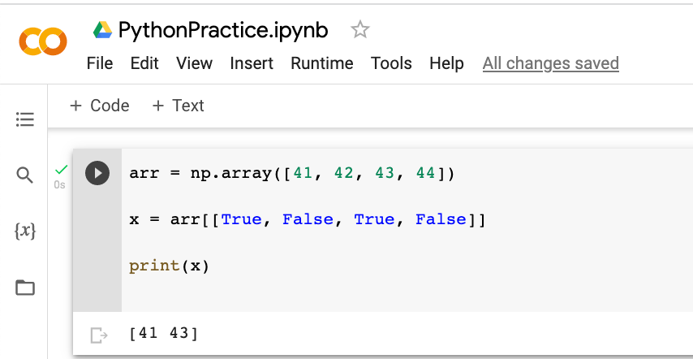
Google Colab

Slide 81
Google Colab
Filtering Arrays
Creating the Filter Array
In the example above we hard-coded the True and False values, but the common use is to create a filter array based on conditions.
Example
Create a filter array that will return only values higher than 42.

Slide 82
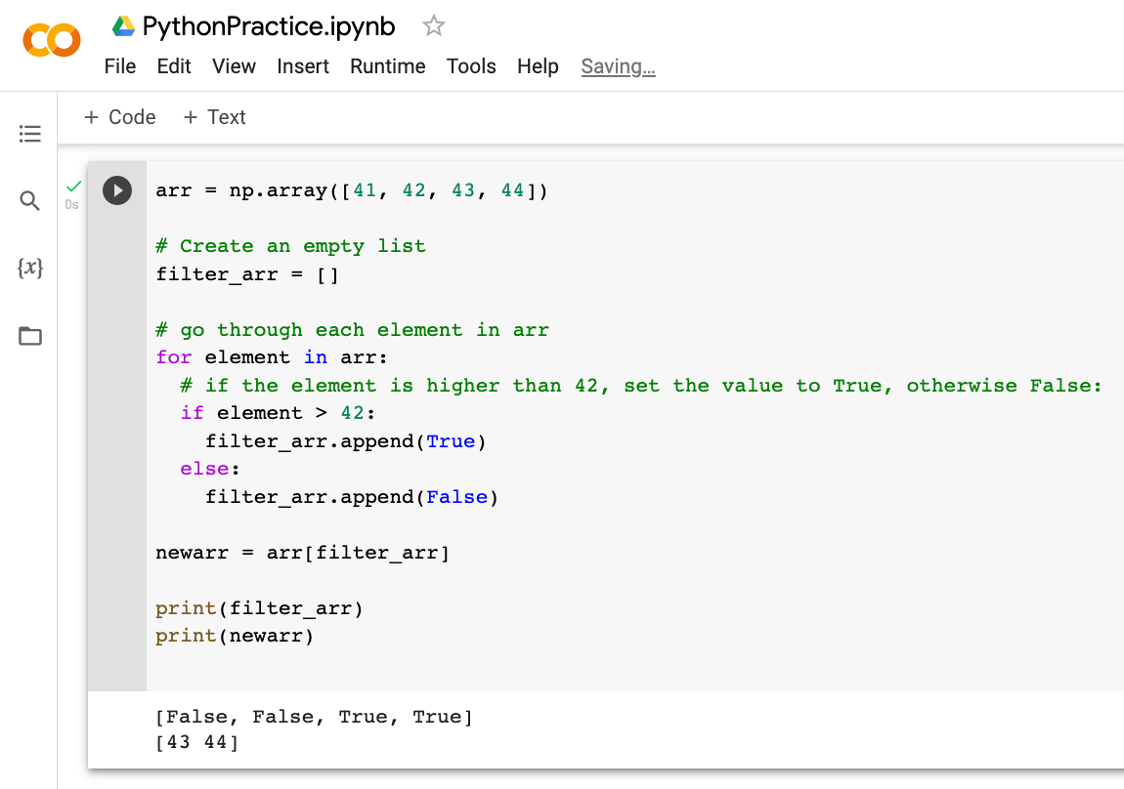
Google Colab

Slide 83
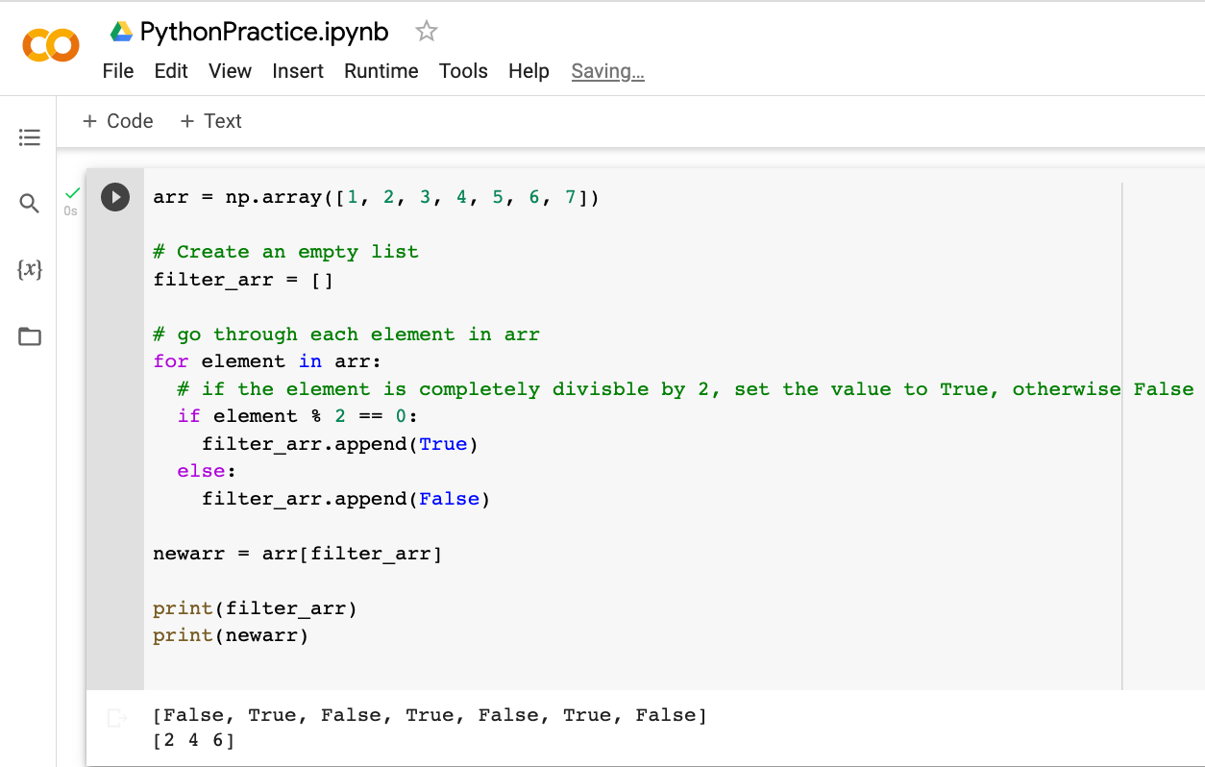
Google Colab

Slide 84
Google Colab
Filtering Arrays
Creating the Filter Array
Creating Filter Directly From Array
The above example is quite a common task in NumPy and NumPy provides a nice way to tackle it.
We can directly substitute the array instead of the iterable variable in our condition and it will work just as we expect it to.

Slide 85
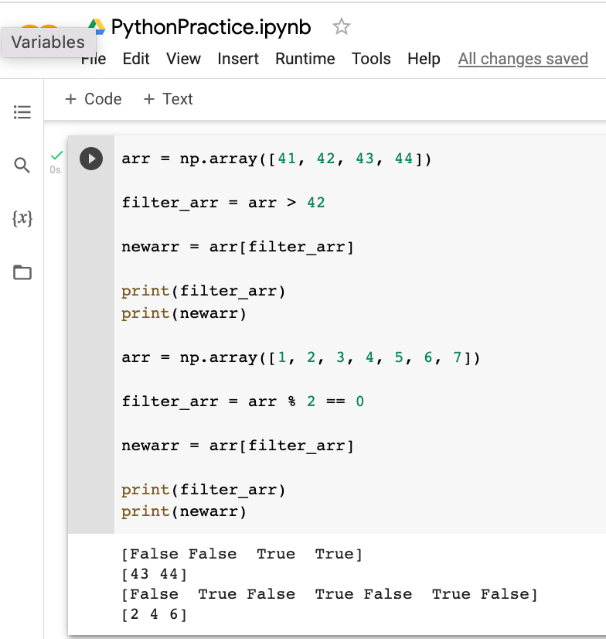
Google Colab

Slide 86
Google Colab
Arrays with initial Values
You can create arrays with initial values. Such as 0 or 1’s or any specific values
Identity matrix creation.

Slide 87
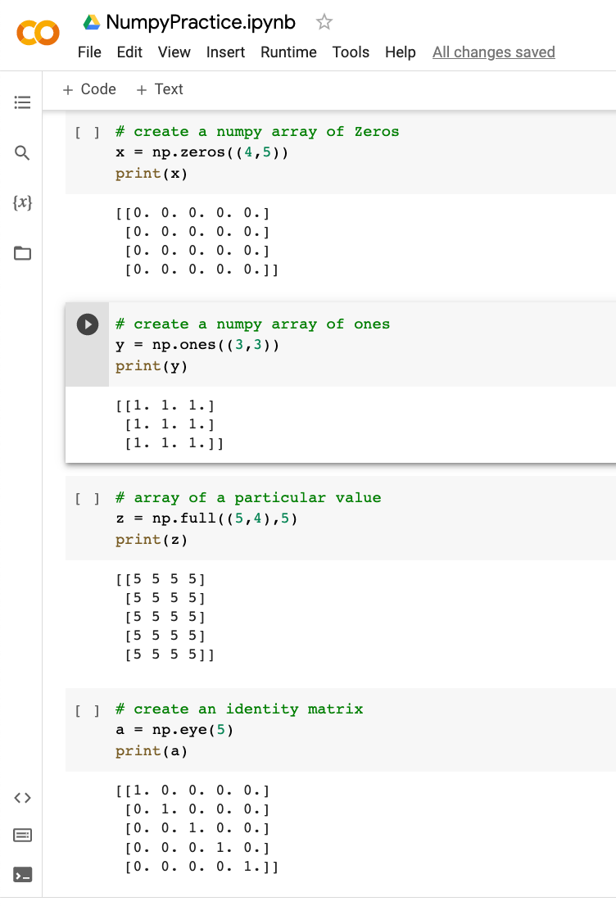
Google Colab

Slide 88
Google Colab
NumPy ufuncs
What are ufuncs?
ufuncs stands for "Universal Functions" and they are NumPy functions that operate on the ndarray object.

Slide 89
Google Colab
NumPy ufuncs
Why use ufuncs?
ufuncs are used to implement vectorization in NumPy which is way faster than iterating over elements.
They also provide broadcasting and additional methods like reduce, accumulate etc. that are very helpful for computation.
What is Vectorization?
Converting iterative statements into a vector based operation is called vectorization.
It is faster as modern CPUs are optimized for such operations.

Slide 90
Google Colab
NumPy ufuncs
ufuncs also take additional arguments, like:
where boolean array or condition defining where the operations should take place.
dtype defining the return type of elements.
out output array where the return value should be copied.

Slide 91
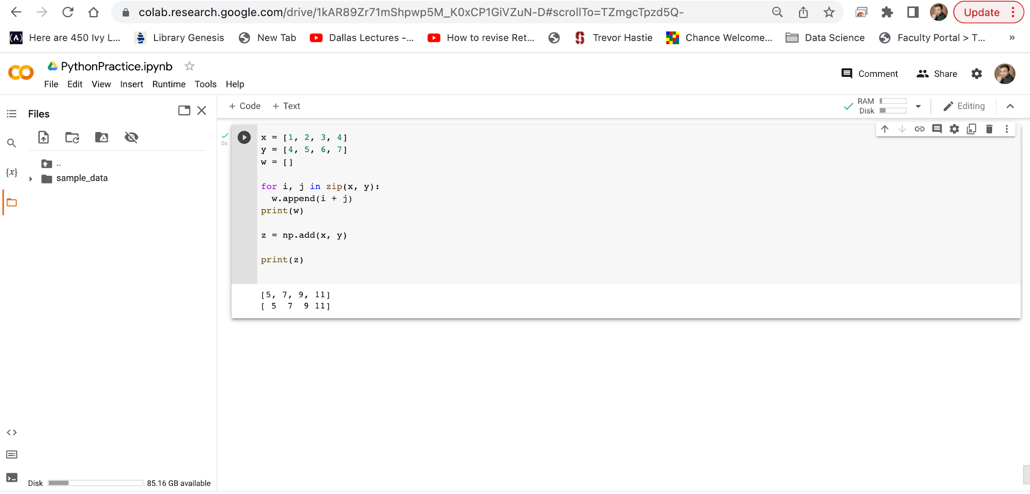
Google Colab
Less efficient version
of adding list by iterating using for loop
Faster ufunc method add

Slide 92
Google Colab
NumPy ufuncs
Create Your Own ufunc
How To Create Your Own ufunc
To create your own ufunc, you have to define a function, like you do with normal functions in Python, then you add it to your NumPy ufunc library with the frompyfunc() method.
The frompyfunc() method takes the following arguments:
function - the name of the function.
inputs - the number of input arguments (arrays).
outputs - the number of output arrays.
How to Check if a Function is a ufunc?
Check the type of a function to check if it is a ufunc or not.
A ufunc should return <class 'numpy.ufunc’>.
If it is not a ufunc, it will return another type, like this built-in NumPy function for joining two or more arrays:

Slide 93

Google Colab
Create your own ufunc for addition.
Added it to numpy library
Called it to add Arrays
Check if myadd is part of ufunc library or not. Like np.add.
You can see that they both have the same type of numpy.ufunc.
Check the type of another function: concatenate(), its function.
To test if the function is a ufunc in an if statement, use the numpy.ufunc value (or np.ufunc if you use np as an alias for numpy

Slide 94
Google Colab
NumPy ufuncs
Simple Arithmetic
You could use arithmetic operators + - * / directly between NumPy arrays, but this section discusses an extension of the same where we have functions that can take any array-like objects e.g. lists, tuples etc. and perform arithmetic conditionally.
Arithmetic Conditionally: means that we can define conditions where the arithmetic operation should happen.
All of the discussed arithmetic functions take a where parameter in which we can specify that condition.

Slide 95
Google Colab
NumPy ufuncs
Simple Arithmetic
You could use arithmetic operators + - * / directly between NumPy arrays, but this section discusses an extension of the same where we have functions that can take any array-like objects e.g. lists, tuples etc. and perform arithmetic conditionally.
Arithmetic Conditionally: means that we can define conditions where the arithmetic operation should happen.
All of the discussed arithmetic functions take a where parameter in which we can specify that condition.

Slide 96
Google Colab
NumPy ufuncs
Simple Arithmetic
The add() function sums the content of two arrays, and return the results in a new array.
The subtract() function subtracts the values from one array with the values from another array, and return the results in a new array.
The multiply() function multiplies the values from one array with the values from another array, and return the results in a new array.
The divide() function divides the values from one array with the values from another array, and return the results in a new array.
The power() function rises the values from the first array to the power of the values of the second array, and return the results in a new array.
Both the mod() and the remainder() functions return the remainder of the values in the first array corresponding to the values in the second array, and return the results in a new array.
The divmod() function return both the quotient and the the mod. The return value is two arrays, the first array contains the quotient and second array contains the mod.
Both the absolute() and the abs() functions do the same absolute operation element-wise but we should use absolute() to avoid confusion with python's inbuilt math.abs()

Slide 97

Google Colab
Add the values in arr1 to the values in arr2.
Sum the values in arr1 and the values in arr2.
Summation Over an Axis
If you specify axis=1, NumPy will sum the numbers in each array.
Here we perform summation in the array over 1st axis.
Cummulative Sum
Cummulative sum means partially adding the elements in array.
E.g. The partial sum of [1, 2, 3, 4] would be [1, 1+2, 1+2+3, 1+2+3+4] = [1, 3, 6, 10].
Perfom partial sum with the cumsum() function.

Slide 98


Google Colab

Slide 99

Google Colab
subtracting the values in arr1 to the values in arr2.
A discrete difference means subtracting two successive elements.
E.g. for [1, 2, 3, 4], the discrete difference would be [2-1, 3-2, 4-3] = [1, 1, 1]
To find the discrete difference, use the diff() function.
It returns [5 10 -20] because 15-10=5, 25-15=10, and 5-25=-20
We can perform discrete difference repeatedly by giving parameter n. E.g. for [1, 2, 3, 4], the discrete difference with n = 2 would be [2-1, 3-2, 4-3] = [1, 1, 1] , then, since n=2, we will do it once more, with the new result: [1-1, 1-1] = [0, 0]
It returns: [5 -30] because: 15-10=5, 25-15=10, and 5-25=-20 AND 10-5=5 and -20-10=-30

Slide 100

Google Colab
multiply the values in arr1 to the values in arr2.
To find the product of the elements in an array.
Returns: 24 because 1*2*3*4 = 24
Find the product of the elements of two arrays:
Returns: 40320 because 1*2*3*4*5*6*7*8 = 40320
If you specify axis=1, NumPy will return the product of each array.
Returns: [24 1680]
Cummulative Product
Cummulative product means taking the product partially.
E.g. The partial product of [1, 2, 3, 4] is [1, 1*2, 1*2*3, 1*2*3*4] = [1, 2, 6, 24]
Perfom partial product with the cumprod() function. Returns: [5 30 210 1680]

Slide 101

Google Colab
Division
The divide() function divides the values from one array with the values from another array, and return the results in a new array.
Divide the values in arr1 with the values in arr2:
The example above will return [3.33333333 4. 3. 5. 25. 1.81818182] which is the result of 10/3, 20/5, 30/10 etc.

Slide 102

Google Colab
Power
The power() function rises the values from the first array to the power of the values of the second array, and return the results in a new array.
The example above will return [1000 3200000 729000000 6553600000000 2500 0] which is the result of 10*10*10, 20*20*20*20*20, 30*30*30*30*30*30 etc.

Slide 103

Google Colab
Remainder
Both the mod() and the remainder() functions return the remainder of the values in the first array corresponding to the values in the second array, and return the results in a new array.
The example above will return [1 6 3 0 0 27] which is the remainders when you divide 10 with 3 (10%3), 20 with 7 (20%7) 30 with 9 (30%9) etc.

Slide 104

Google Colab
Quotient and Mod
The divmod() function return both the quotient and the the mod. The return value is two arrays, the first array contains the quotient and second array contains the mod.
The example above will return:
(array([3, 2, 3, 5, 25, 1]), array([1, 6, 3, 0, 0, 27]))
The first array represents the quotients, (the integer value when you divide 10 with 3, 20 with 7, 30 with 9 etc.
The second array represents the remainders of the same divisions.

Slide 105

Google Colab
Absolute Values
Both the absolute() and the abs() functions do the same absolute operation element-wise but we should use absolute() to avoid confusion with python's inbuilt math.abs()
The example above will return [1 2 1 2 3 4].

Slide 106
Google Colab
NumPy ufuncs
NumPy Logs
NumPy provides functions to perform log at the base 2, e and 10.
We will also explore how we can take log for any base by creating a custom ufunc.
All of the log functions will place -inf or inf in the elements if the log can not be computed.

Slide 107

Google Colab
The arange(1, 10) function returns an array with integers starting from 1 (included) to 10 (not included).
print("Printing Result of Log at base 2 of each element of above array")
print("Printing Result of Log at base 10 of each element of above array")
print("Printing Result of Natural Log, or Log at Base e of each element of above array")

Slide 108
Google Colab
NumPy ufuncs
Rounding Decimals
There are primarily five ways of rounding off decimals in NumPy:
truncation
fix
rounding
floor
ceil

Slide 109
Google Colab
NumPy ufuncs
Rounding Decimals
Truncation
Remove the decimals, and return the float number closest to zero. Use the trunc() and fix() functions.
Rounding
The around() function increments preceding digit or decimal by 1 if >=5 else do nothing.
E.g. round off to 1 decimal point, 3.16666 is 3.2
Floor
The floor() function rounds off decimal to nearest lower integer.
E.g. floor of 3.166 is 3.
Ceil
The ceil() function rounds off decimal to nearest upper integer.
E.g. ceil of 3.166 is 4.

Slide 110

Google Colab
Remove the decimals, and return the float number closest to zero. [-3., -3.]
Around function increments preceding digit or decimal by 1 if >=5 else do nothing.
round off to 1 decimal point, 3.16666 is 3.2
The floor() function rounds off decimal to nearest lower integer. floor of 3. 667 is 3. and -3.1666 is -4.
The ceil() function rounds off decimal to nearest upper integer.
E.g. ceil of 3.166 is 4.

Slide 111

Google Colab
Finding LCM (Lowest Common Multiple)
The Lowest Common Multiple is the smallest number that is a common multiple of two numbers.
Example
Find the LCM of the following two numbers: 4 and 6 Returns: 12 because that is the lowest common multiple of both numbers (4*3=12 and 6*2=12).
The arange(1, 11) function returns an array with integers starting from 1 (included) to 11 (not included).
Finding LCM in Arrays
To find the Lowest Common Multiple of all values in an array, you can use the reduce() method.
The reduce() method will use the ufunc, in this case the lcm() function, on each element, and reduce the array by one dimension.
Example
Find the LCM of the values of the following array:
Returns: 18 because that is the lowest common multiple of all three numbers (3*6=18, 6*3=18 and 9*2=18).

Slide 112

Google Colab
Finding GCD (Greatest Common Denominator)
The GCD (Greatest Common Denominator), also known as HCF (Highest Common Factor) is the biggest number that is a common factor of both of the numbers.
Find the HCF of the following two numbers:
Returns: 3 because that is the highest number both numbers can be divided by (6/3=2 and 9/3=3).
Finding GCD in Arrays
To find the Highest Common Factor of all values in an array, you can use the reduce() method. The reduce() method will use the ufunc, in this case the gcd() function, on each element, and reduce the array by one dimension.
Find the GCD for all of the numbers in the following array:
Returns: 4 because that is the highest number all values can be divided by.

Slide 113
Google Colab
NumPy ufuncs
NumPy Trigonometric Functions
NumPy provides the ufuncs sin(), cos() and tan() that take values in radians and produce the corresponding sin, cos and tan values.

Slide 114

Google Colab
NumPy ufuncs
NumPy Trigonometric Functions
NumPy provides the ufuncs sin(), cos() and tan() that take values in radians and produce the corresponding sin, cos and tan values.

Slide 115

Google Colab
NumPy ufuncs
NumPy Trigonometric Functions
NumPy provides the ufuncs sin(), cos() and tan() that take values in radians and produce the corresponding sin, cos and tan values.
Convert Degrees Into Radians
By default all of the trigonometric functions take radians as parameters but we can convert radians to degrees and vice versa as well in NumPy.
Note: radians values are pi/180 * degree_values.
Convert all of the values in following array arr to radians.
Radians to Degrees
Convert all of the values in following array arr to degrees.

Slide 116

Google Colab
NumPy Trigonometric Functions
We took this angle in radian 1.0471975511965976 that is equal to 60 degree and calculated and printed its sin(), cos() and tan() value.
NumPy provides the ufuncs sin(), cos() and tan() that take values in radians and produce the corresponding sin, cos and tan values.
We created the array of angle in radian. [0, 30, 45, 60, 90]
calculated and printed the sin(), cos() and tan() value of each element of array.
Finding Angles
Finding angles from values of sine, cos, tan. E.g. sin, cos and tan inverse (arcsin, arccos, arctan).
NumPy provides ufuncs arcsin(), arccos() and arctan() that produce radian values for corresponding sin, cos and tan values given.

Slide 117
Google Colab
NumPy ufuncs
Hypotenues
Finding hypotenues using pythagoras theorem in NumPy.
NumPy provides the hypot() function that takes the base and perpendicular values and produces hypotenues based on pythagoras theorem.
Find the hypotenues for 4 base and 3 perpendicular.

Slide 118

Google Colab

Slide 119

Google Colab

Slide 120
Google Colab
NumPy ufuncs
Hyperbolic Functions
NumPy provides the ufuncs sinh(), cosh() and tanh() that take values in radians and produce the corresponding sinh, cosh and tanh values.

Slide 121
Google Colab
Hyperbolic Functions
We took this angle in radian 1.0471975511965976 that is equal to 60 degree and calculated and printed its sinh(), cosh() and tanh() value.
NumPy provides the ufuncs sinh(), cosh() and tanh() that take values in radians and produce the corresponding sinh, cosh and tanh values.
We created the array of angle in radian. [0, 30, 45, 60, 90]
calculated and printed the sinh(), cosh() and tanh() value of each element of array.
Finding Angles
Finding angles from values of hyperbolic sine, cos, tan. E.g. sinh, cosh and tanh inverse (arcsinh, arccosh, arctanh).
Numpy provides ufuncs arcsinh(), arccosh() and arctanh() that produce radian values for corresponding sinh, cosh and tanh values given.

Slide 122
Google Colab
NumPy ufuncs
NumPy Set Operations
What is a Set
A set in mathematics is a collection of unique elements.
Sets are used for operations involving frequent intersection, union and difference operations.
Create Sets in NumPy
We can use NumPy's unique() method to find unique elements from any array. E.g. create a set array, but remember that the set arrays should only be 1-D arrays.

Slide 123

Google Colab
Convert following array with repeated elements to a set.
Finding Union
To find the unique values of two arrays, use the union1d() method.
Finding Intersection
To find only the values that are present in both arrays, use the intersect1d() method. Find intersection of the two set arrays. The intersect1d() method takes an optional argument assume_unique, which if set to True can speed up computation. It should always be set to True when dealing with sets.
Finding Difference
To find only the values in the first set that is NOT present in the seconds set, use the setdiff1d() method.
Find the difference of the set1 from set2.
Finding Symmetric Difference
To find only the values that are NOT present in BOTH sets, use the setxor1d() method.

Slide 124
Google Colab
Random Numbers in NumPy
What is a Random Number?
Random number does NOT mean a different number every time. Random means something that can not be predicted logically.

Slide 125
Google Colab
Random Numbers in NumPy
Pseudo Random and True Random.
Computers work on programs, and programs are definitive set of instructions.
So it means there must be some algorithm to generate a random number as well.
If there is a program to generate random number it can be predicted, thus it is not truly random.
Random numbers generated through a generation algorithm are called pseudo random.

Slide 126
Google Colab
Random Numbers in NumPy
Pseudo Random and True Random.
Can we make truly random numbers?
Yes. In order to generate a truly random number on our computers we need to get the random data from some outside source.
This outside source is generally our keystrokes, mouse movements, data on network etc.
We do not need truly random numbers, unless its related to security (e.g. encryption keys) or the basis of application is the randomness (e.g. Digital roulette wheels).
In this tutorial we will be using pseudo random numbers.

Slide 127
Google Colab
Random Numbers in NumPy
Generate Random Number
NumPy offers the random module to work with random numbers.
randint() Generate a random integer from 0 to 100. The randint() method takes a size parameter where you can specify the shape of an array.
rand()
The random module's rand() method returns a random float between 0 and 1.
Generate Random Number From Array
The choice() method allows you to generate a random value based on an array of values.
The choice() method takes an array as a parameter and randomly returns one of the values.
The choice() method also allows you to return an array of values.
Add a size parameter to specify the shape of the array.

Slide 128
Google Colab
Random Numbers in NumPy
Generate Random Array
In NumPy we work with arrays, and you can use the methods from the above examples to make random arrays.

Slide 129

Google Colab
Generate a random integer from 0 to 100.
Generate a random float from 0 to 1.
Generate a 1-D array containing 5 random integers from 0 to 100.
Generate a 2-D array with 3 rows, each row containing 5 random integers from 0 to 100.
Generate a 1-D array containing 5 random float from 0 to 1.
Generate a 2-D array with 3 rows, each row containing 5 random floats from 0 to 1.
Return one of the values in an array of selection [3 5 7 8]
Generate a 2-D array 3 rows, each row containing 5 elements that consists of the values in the array parameter (3, 5, 7, and 9):

Slide 130

Google Colab

Slide 131

Google Colab

Slide 132
Google Colab
Random Numbers in NumPy
What is Data Distribution?
Data Distribution is a list of all possible values, and how often each value occurs.
Such lists are important when working with Machine learning and data science.
The random module offer methods that returns randomly generated data distributions.

Slide 133
Google Colab
Random Numbers in NumPy
Random Distribution
A random distribution is a set of random numbers that follow a certain probability density function.
Probability Density Function: A function that describes a continuous probability. i.e. probability of all values in an array.
We can generate random numbers based on defined probabilities using the choice() method of the random module.
The choice() method allows us to specify the probability for each value.
The probability is set by a number between 0 and 1, where 0 means that the value will never occur and 1 means that the value will always occur.

Slide 134

Google Colab
Generate a 1-D array containing 100 values, where each value has to be 3, 5, 7 or 9.
The probability for the value to be 3 is set to be 0.1
The probability for the value to be 5 is set to be 0.3
The probability for the value to be 7 is set to be 0.6
The probability for the value to be 9 is set to be 0.
The sum of all probability numbers should be 1.
You can return arrays of any shape and size by specifying the shape in the size parameter.
Even if you run the example above 100 times, the value 9 will never occur.

Slide 135
Google Colab
Random Numbers in NumPy
Random Permutations
Random Permutations of Elements
A permutation refers to an arrangement of elements. e.g. [3, 2, 1] is a permutation of [1, 2, 3] and vice-versa.
The NumPy Random module provides two methods for this: shuffle() and permutation().
Shuffling Arrays
Shuffle means changing arrangement of elements in-place. i.e. in the array itself. The shuffle() method makes changes to the original array.
The permutation() method returns a re-arranged array (and leaves the original array un-changed).

Slide 136

Google Colab
Randomly shuffle elements of following array.
Generate a random permutation of elements of following array.

Slide 137
Slide Title
Make Effective Presentations
Using Awesome Backgrounds
Engage your Audience
Capture Audience Attention

Slide 138
Slide Title
Product A
Product B
Feature 1
Feature 2
Feature 3
Feature 1
Feature 2
Feature 3

Slide 139


